Slide 1
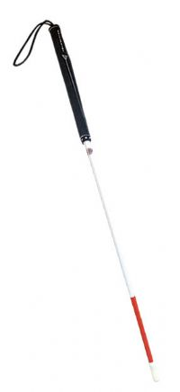
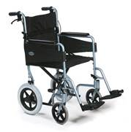
Quincy and Kyle tackle handicaps
(double entendre)

Slide 2
VIDEO
Stigma—sign of social unacceptability: the shame or disgrace attached to something regarded as socially unacceptable
  Often surround disabilities
    The stigma of a wheelchairs
      Curb Your Enthusiasm (satire)

Slide 3
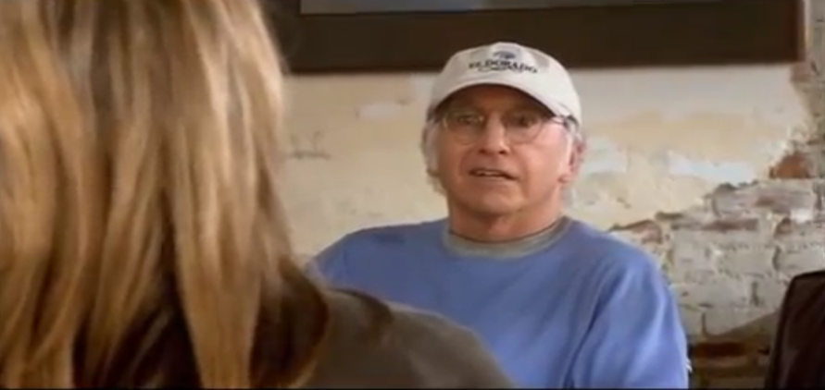

Slide 4
Appetizer
TIME: 12 minutes
2 minutes—think of an example from a movie, TV show, book, or anything from our culture that shows discrimination based on a physical or mental handicap
10 minutes—write (OneNote or Word) Do you believe the depictions of handicapped people to be accurate or not? Has the media affected your view/stigma of disabled people?

Slide 5
An “anadote” about perception
Last year I entered my first university class of the semester. I have my iPod with me, and a political science textbook: I'm a couple of minutes early. An older lady twice my age comes up to me; she waves her arms. In a slow loud voice she says:
'Are you lost?'
'No, I'm in the right room,' I say.
'Are you sure?'
'Yes, I'm sure.'
'I've never thought someone in a wheelchair would be interested in politics.'
With that I look up at the clock, realise it is the top of the hour and take my position behind the desk at the front of the room.
'Hi, Welcome to Introduction to Australian Politics. I'm your tutor this semester.'
I look at the woman who has turned bright red with embarrassment.
That story sums up my life.
http://www.abc.net.au/rampup/articles/2010/12/01/3081663.htm

Slide 6
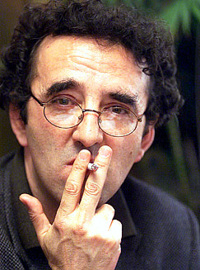
"People see what they want to see and what people want to see never has anything to do with the truth.”
- Roberto Bolano

Slide 7
GOALS
To demonstrate how popular perception characterizes disabled people as lesser
  Pity, misunderstanding, underestimation of handicapped (Joe Muhammad)
  Disabled people viewed as burdensome (Sensei)
To explore how our own perceptions affect those who are stigmatized
  The disabled person’s point of view
    (Born on the Fourth of July, Johnny Got His Gun)
To identify ways to combat the stigmas and stereotypes associated with disabilities

Slide 8
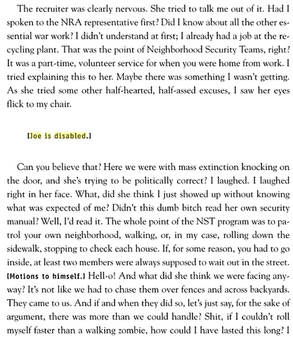
Joe Muhammad (152)
NST rep. = satire of humans’ inclination to underestimate and baby handicapped
Doesn’t see himself differently
Realist, passionate, pissed off
Approaches the situation with humor
Talks the talk and walks/rolls the walk → kills a man when necessary

Slide 9
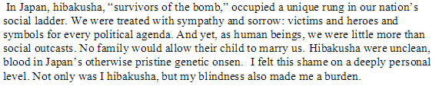
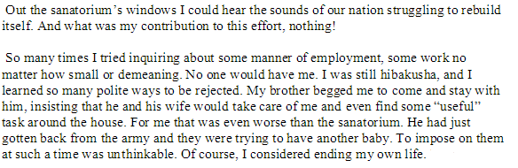
Sensei Tomonaga Ijiro (217)
Satirizing our lack of recognition for older veterans, grandparents? Who do we view as burdens?

Slide 10
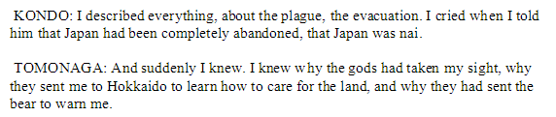
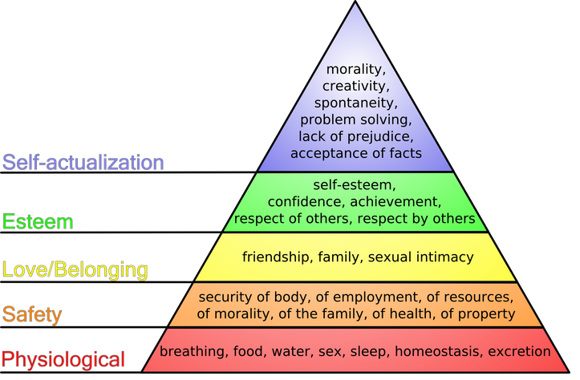
What message is Brooks trying to get across here? Connection to Maslow?

Slide 11
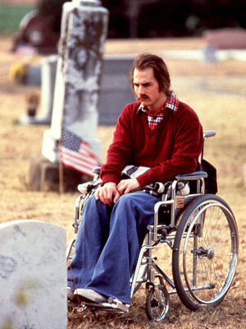
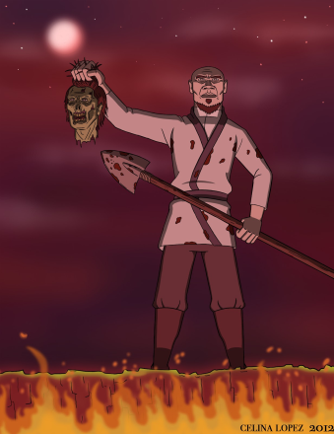
Born on the Fourth of July and
Sensei Tomonaga Ijiro in WWZ
Ron Kovic
Sensei Tomonaga Ijiro
Vietnam War veteran
Paralyzed, PTSD
Celebrated, paraded around, accolades
Faces reality
Family feels obligated to take care of him
Wishes death
Atomic Bomb “hibakusha”
Social outcast, blind
“Victims and heroes and symbols for every political agenda”
Feels like a burden to his family
Contemplates suicide
BOTFOJ clip
Themes of war?

Slide 12
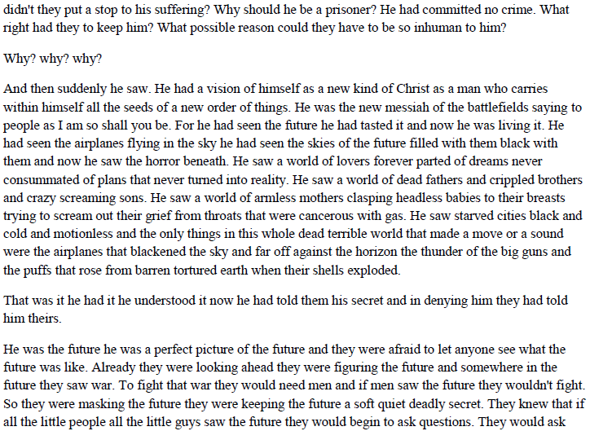
Johnny Got His Gun

Slide 13
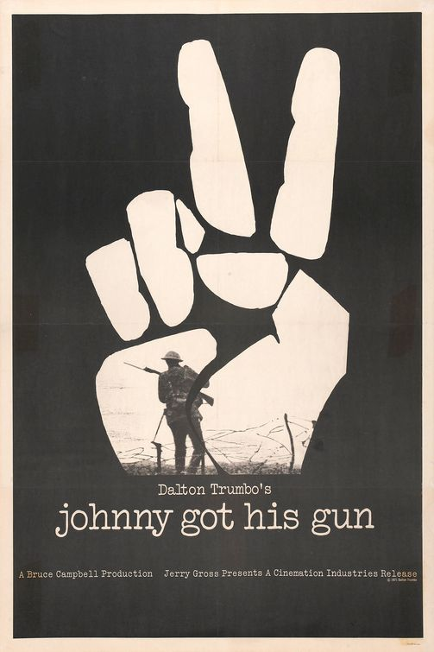
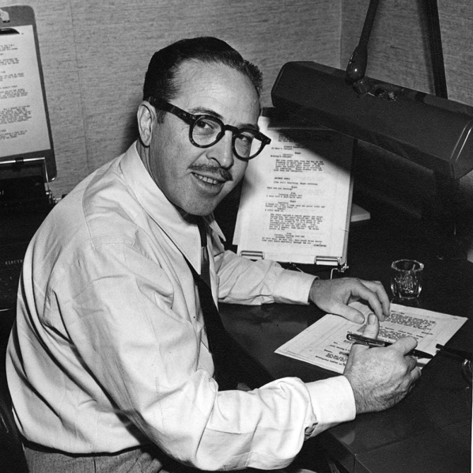
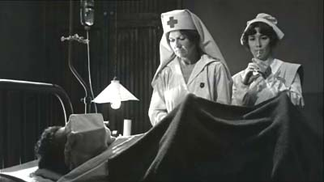
DISCUSSION: Do you think Ron Kovic would have gone to war if had he seen Joe? If he had read Johnny Got His Gun?
Do you agree with Trumbo’s assertion that the government, especially the military, tries to minimize negative publicity for the sake of recruitment
  “To fight that war they would need men and if men saw the future they wouldn't fight. So they were masking the future they were keeping the future a soft quiet deadly secret.”
What do you think Trumbo is trying to satirize most through his book?

Slide 14
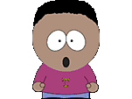
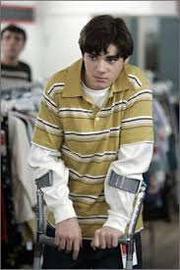
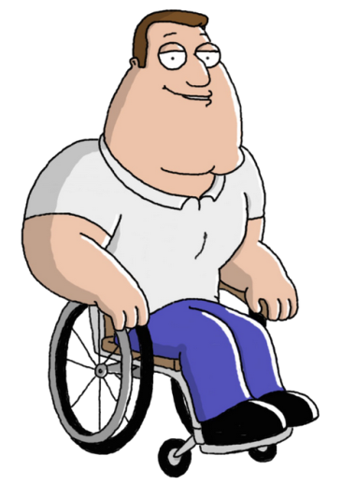
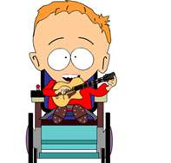
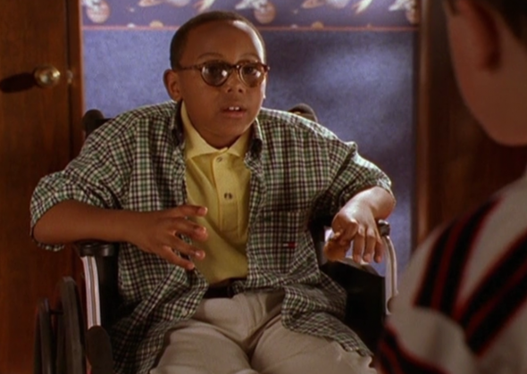
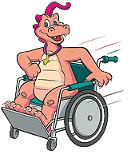
Token Minority
Token minority—a character designed to get more minority groups into the plot
  Broadens appeal, producers avoid criticism, allows race jokes related to minority without any shame

Slide 15
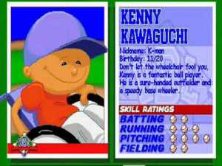
Do you think that the idea of “token minorities” combats stigmas or perpetuates them?
SCENARIO: It’s 2025 and you are successful game designer. You are working on Backyard Baseball 2025 and you have to decide whether or not to include a physically handicapped person in the game. What do you decide?
What are the pros and cons of including Kenny Kawaguchi in the game?

Slide 16
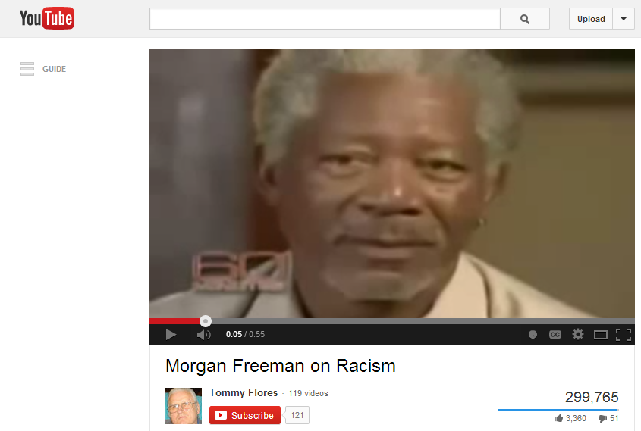
How can we combat stereotypes and stigmas of handicapped people?
Morgan Freeman on 60 Minutes
Do you agree with Freeman’s ideas? Should these principles be applied to how we deal with handicapped people in our lives and in the media?

Slide 17
BLOG POST
Revise and post your in-class writing about your perception of handicapped people and media’s effect on the depiction of people with disabilities
MORE CREATIVE WRITING: Suppose Dalton Trumbo went to Moeller. Compose a piece written in his style (notice grammar and punctuation) about things that Moeller would not want prospective 8th grade students to know about. Keep it appropriate.

