Slide 1
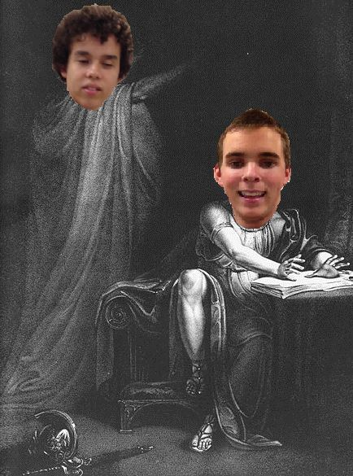
Brutus’s Speech to the Roman Populace in Julius Caesar

Slide 2
H’what (aspiration) happens? The events that incite Brutus to speak
Roman officials fed up with people blindly following Caesar—too much power
Cassius plans assassination of Caesar, deceitfully recruits Brutus to join him
Caesar ignores wife’s warning, gets murdered
Never ignore advice from a woman named Calpurnia
Brutus & Cassius win over Romans with speeches

Slide 3
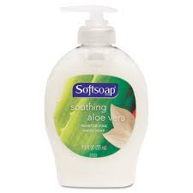
SOAPS

Slide 4
Subject
Brutus is addressing…
Caesar’s tyrannical and ambitious aspirations
his own love for his country
why Caesar had to be killed

Slide 5
Occasion
The Roman populace just heard about Caesar’s death—they are angry, confused, seeking answers

Slide 6
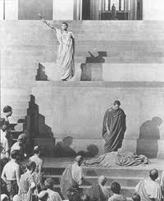
Audience
“Romans, countrymen, and lovers…”

Slide 7
Purpose
Stop the bleeding
Justify Caesar’s death
Unite a broken country

Slide 8
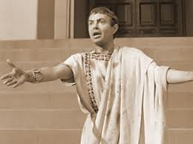
Speaker
Brutus

Slide 9
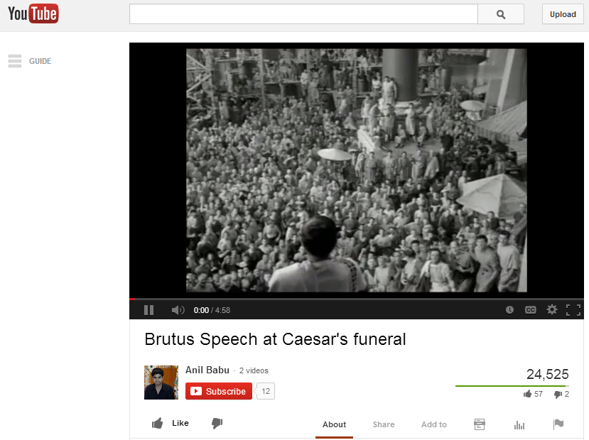
Brutus’s speech to the Roman populace
http://www.youtube.com/watch?v=wM6X-8dokRE

Slide 10
Strategies—appeals utilized
“Romans, countrymen, and lovers” –ethos
“Not that I loved Caesar less, but that I loved Rome more.” –antithesis
“…as I slew my best lover for the good of Rome, I have the same dagger for myself, when it shall please my country to need my death.”—ethos
“As Caesar loved me, I weep for him…”
Intimidation: “Who is here so rude…”
“Had you rather Caesar were living and die all slaves, than that Caesar were dead, to live all free men?”

Slide 11
Diction
A gold mine of archaic language
The tone of the speech is formal and explanative
“…his glory not extenuated, wherein he was worthy, nor his offences enforced, for which he suffered death.”

