Slide 1
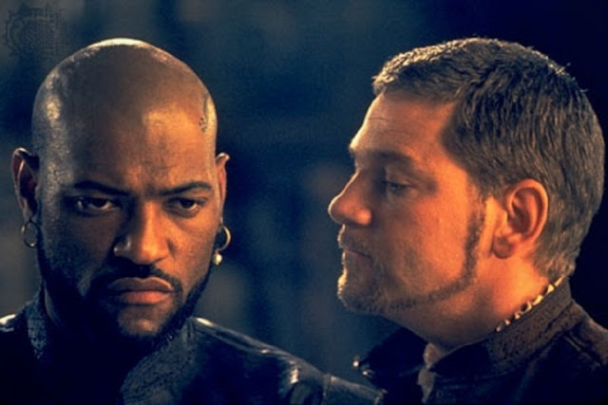
The Tragedy of Othello, the Moor of Venice
Evan Verrilli & Danny Bruns

Slide 2
Summary
Iago tells Othello that Desdemona is cheating on him with Cassio
He supports this by telling Othello that he saw Cassio dream of Desdemona
Othello is convinced, but Iago tells him to wait for more evidence
Iago then tells Othello that he saw Cassio with Desdemona’s handkerchief (Othello’s first gift to her)
Othello becomes enraged and swears to kill Desdemona

Slide 3
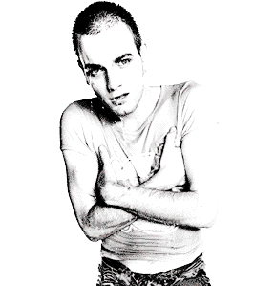
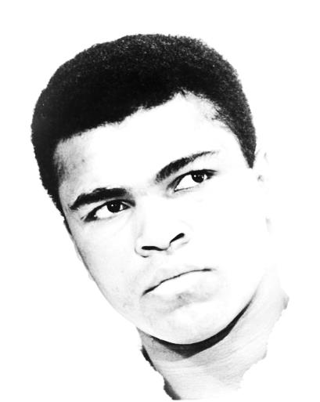
S.O.A.P.S.
IAGO
OTHELLO
Subject
The infidelity of Desdemona
Occasion
Iago wishes to convince Othello of Desdemona’s unfaithfulness
Audience
Othello – Noble Venetian who Iago despises
Purpose
To persuade Othello of his wife’s disloyalty
Speaker
Iago – Venetian soldier and pseudo-friend of Othello
Subject
The infidelity of Desdemona
Occasion
Othello is trying to decide whether or not his wife is faithful
Audience
Iago – Soldier under Othello; holds his trust
Purpose
To understand his wife’s loyalty
Speaker
Othello – Venetian general and trusting friend of Iago

Slide 4
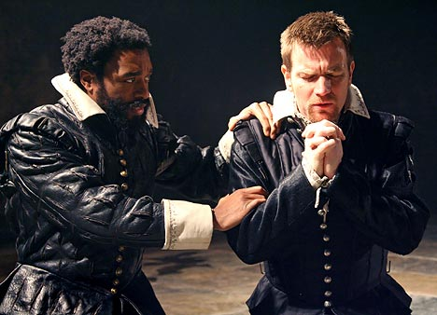
Video
http://www.youtube.com/watch?v=8u1AENcTNbc

Slide 5
Text & Annotation
OTHELLO
Give me a living reason she's disloyal.
IAGO
I do not like the office: But, sith I am enter'd in this cause so far, Prick'd to't by foolish honesty and love, I will go on. I lay with Cassio lately; And, being troubled with a raging tooth, I could not sleep. There are a kind of men so loose of soul, That in their sleeps will mutter their affairs: One of this kind is Cassio: In sleep I heard him say 'Sweet Desdemona, Let us be wary, let us hide our loves;' And then, sir, would he gripe and wring my hand, Cry 'O sweet creature!' and then kiss me hard, As if he pluck'd up kisses by the roots That grew upon my lips: then laid his leg Over my thigh, and sigh'd, and kiss'd; and then Cried 'Cursed fate that gave thee to the Moor!'
OTHELLO
O monstrous! monstrous!
IAGO
Nay, this was but his dream.
OTHELLO
But this denoted a foregone conclusion: 'Tis a shrewd doubt, though it be but a dream.
IAGO
And this may help to thicken other proofs That do demonstrate thinly.
OTHELLO
I'll tear her all to pieces.
IAGO
Nay, but be wise: yet we see nothing done; She may be honest yet. Tell me but this, Have you not sometimes seen a handkerchief Spotted with strawberries in your wife's hand?
OTHELLO
I gave her such a one; 'twas my first gift.
IAGO
I know not that; but such a handkerchief — I am sure it was your wife's—did I to-day See Cassio wipe his beard with.
OTHELLO
If it be that--
IAGO
If it be that, or any that was hers, It speaks against her with the other proofs.
OTHELLO
O, that the slave had forty thousand lives! One is too poor, too weak for my revenge. Now do I see 'tis true. Look here, Iago; All my fond love thus do I blow to heaven. 'Tis gone. Arise, black vengeance, from thy hollow cell! Yield up, O love, thy crown and hearted throne To tyrannous hate! Swell, bosom, with thy fraught, For 'tis of aspics' tongues!

Slide 6
List of Rhetorical Devices
Alliteration
Allusion
Anaphora
Antimetabole
Antithesis
Archaic Diction
Asyndeton
Cumulative Sentence
Hortative Sentence
Imperative Sentence
Inversion
Juxtaposition
Metaphor
Metonymy
Oxymoron
Parallelism
Periodic Sentence
Personification
Rhetorical Question
Zeugma

Slide 7
Text & Annotation
OTHELLO
Give me a living reason she's disloyal.
IAGO
I do not like the office: But, sith I am enter'd in this cause so far, Prick'd to't by foolish honesty and love, I will go on. I lay with Cassio lately; And, being troubled with a raging tooth, I could not sleep. There are a kind of men so loose of soul, That in their sleeps will mutter their affairs: One of this kind is Cassio: In sleep I heard him say 'Sweet Desdemona, Let us be wary, let us hide our loves;' And then, sir, would he gripe and wring my hand, Cry 'O sweet creature!' and then kiss me hard, As if he pluck'd up kisses by the roots That grew upon my lips: then laid his leg Over my thigh, and sigh'd, and kiss'd; and then Cried 'Cursed fate that gave thee to the Moor!'
OTHELLO
O monstrous! monstrous!
IAGO
Nay, this was but his dream.
OTHELLO
But this denoted a foregone conclusion: 'Tis a shrewd doubt, though it be but a dream.
IAGO
And this may help to thicken other proofs That do demonstrate thinly.
OTHELLO
I'll tear her all to pieces.
IAGO
Nay, but be wise: yet we see nothing done; She may be honest yet. Tell me but this, Have you not sometimes seen a handkerchief Spotted with strawberries in your wife's hand?
OTHELLO
I gave her such a one; 'twas my first gift.
IAGO
I know not that; but such a handkerchief— I am sure it was your wife's—did I to-day See Cassio wipe his beard with.
OTHELLO
If it be that--
IAGO
If it be that, or any that was hers, It speaks against her with the other proofs.
OTHELLO
O, that the slave had forty thousand lives! One is too poor, too weak for my revenge. Now do I see 'tis true. Look here, Iago; All my fond love thus do I blow to heaven. 'Tis gone. Arise, black vengeance, from thy hollow cell! Yield up, O love, thy crown and hearted throne To tyrannous hate! Swell, bosom, with thy fraught, For 'tis of aspics' tongues!

Slide 8
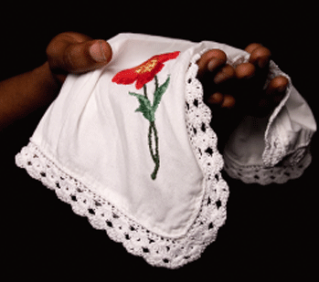
Rhetorical Devices
LOGOS
Handkerchief
Example of Cassio talking in his sleep
ETHOS
Innocent friend – “I know not that”
Saw Cassio with the handkerchief
PATHOS
Diction: gripe, wring, sigh’d, loose of soul
Demonizes Cassio

Slide 9
Rhetorical Devices
Imperative Sentence
“Yield up, O love, thy crown and hearted throne/To tyrannous hate!”
Hortative Sentence
“‘Let us be wary, let us hide our loves;’”
Alliteration
“…do demonstrate…”, “Spotted with strawberries”
Juxtaposition
Iago in place of Desdemona in his story about Cassio

Slide 10
Rhetorical Devices
Personification
“Arise, black vengeance from thy hollow cell!”
Archaic Diction
“Swell, bosom, with thy fraught,/For 'tis of aspics' tongues!”
Inversion
“I know not that. such a handkerchief…did I to-day/See Cassio wipe his beard with.”

Slide 11
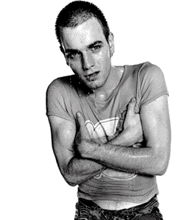
Tone, Motive, & Diction (Iago)
Shite. I’m your friend, mate.
Tone:
Innocent and reluctant
Ethos: Not wanting to talk about Cassio – “I do not like the office”
Motive:
Purpose: To convince Othello of Desdemona’s infidelity
Please Roderigo
Get revenge upon Othello for promoting Cassio
Diction:
“Foolish honesty” – Painful truth
“Loose of soul” – Shows Iago’s truthful view of Cassio
“Thicken proofs” – Substantial evidence
“In your wife’s hand” – If it was hers and now is Cassio’s, she must have given it to Cassio

Slide 12
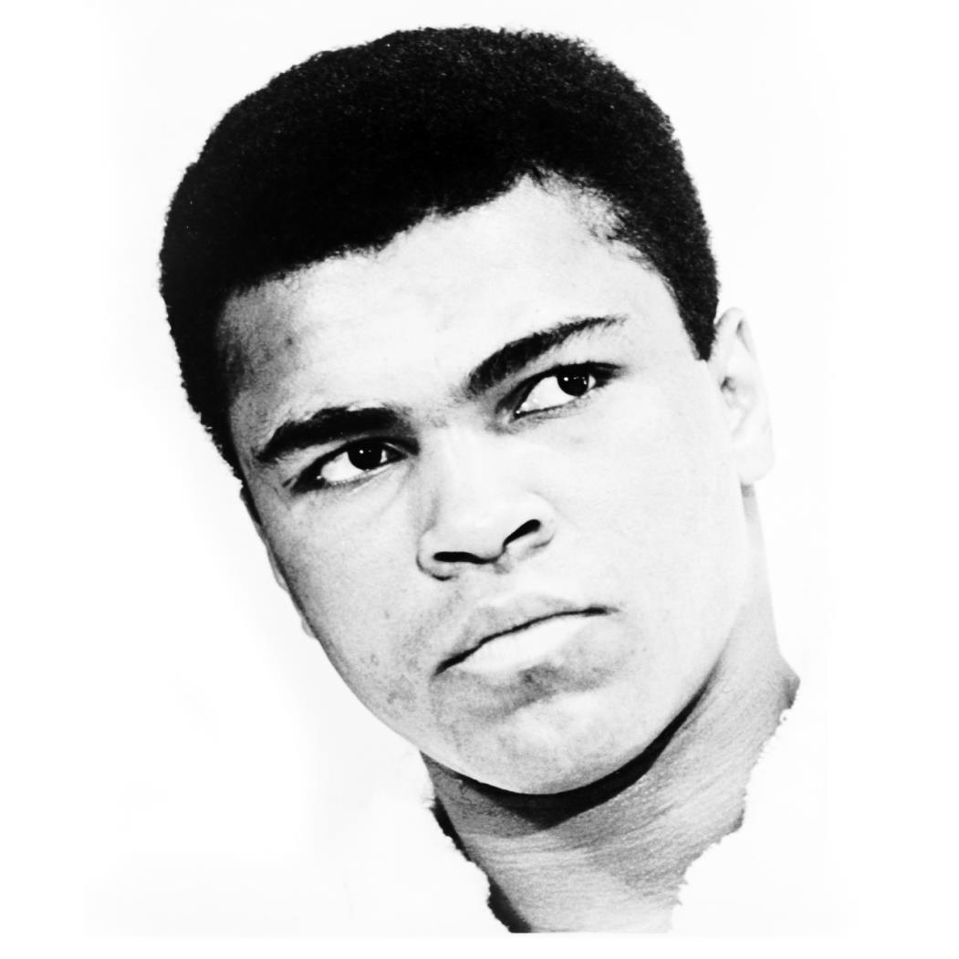
Tone, Motive, & Diction (Othello)
could she?
Tone:
Confused and enraged
“O monstrous! monstrous!”
Motive:
Purpose: Find out his wife’s fidelity
“Give me a living reason she is disloyal.”
Diction:
“Black vengeance” – Othello recognizes the evil he choses to overtake him
“‘Tis a shrewd doubt, though it be but a dream.” – Wants to believe Iago in Desdemona’s unfaithfulness

Slide 13
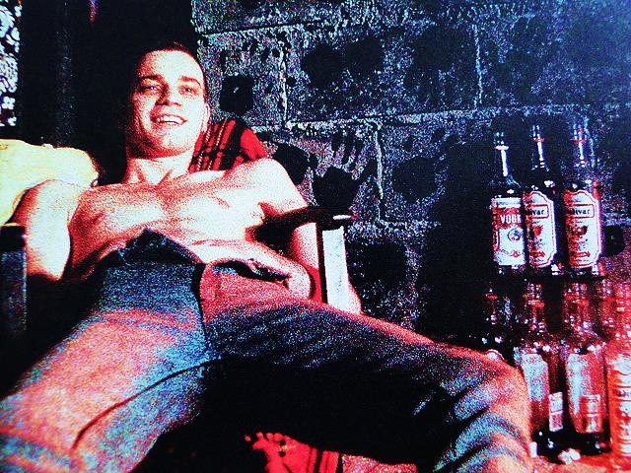
Is Iago Successful?
Yes!
Othello makes Iago lieutenant at the end of Scene III
By the end of the passage, Othello wishes to kill Desdemona and her “lover”
Love$→$ Vengeance
Othello believes Iago’s lies about his “disloyal” wife
A victim of Iago’s persuasion

