Slide 1
Military spending
Kellis Kincaid
Andy “BigRed” Strotman
Joe Pappalardo

Slide 2
Schedule
Watch Blackhawk Down
Expense comparison
How would our army fare in a zombie apocolypse?
Brief background to Duffelblog articles
Duffelblog articles
Discussion
Star Wars
Your assignment

Slide 3
Blackhawk Down
In 1992, the US entered Somalia as part of a peacekeeping force to keep local warlords from controlling the country.
En route to protecting an aid distribution, one of the Blackhawk helicopters for which the affair is named is shot down by a rocket-propelled grenade.
Estimated cost of Blackhawk helicopter: $21,300,000 USD
Estimated cost of RPG-7: < $300 USD
The cost ratio here is 71,000 : 1

Slide 4
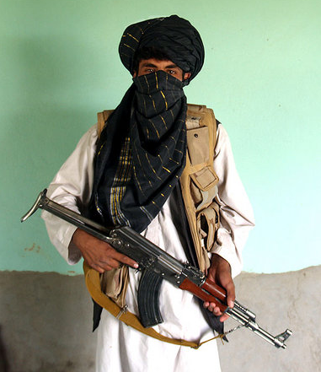
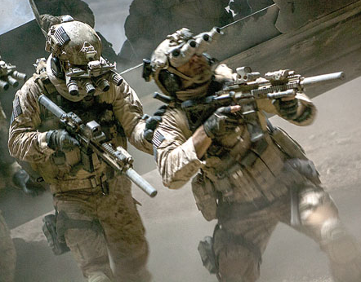
HOW Much does each cost?
US Navy SEAL
Taliban Fighter
$700,000
$1,000

Slide 5
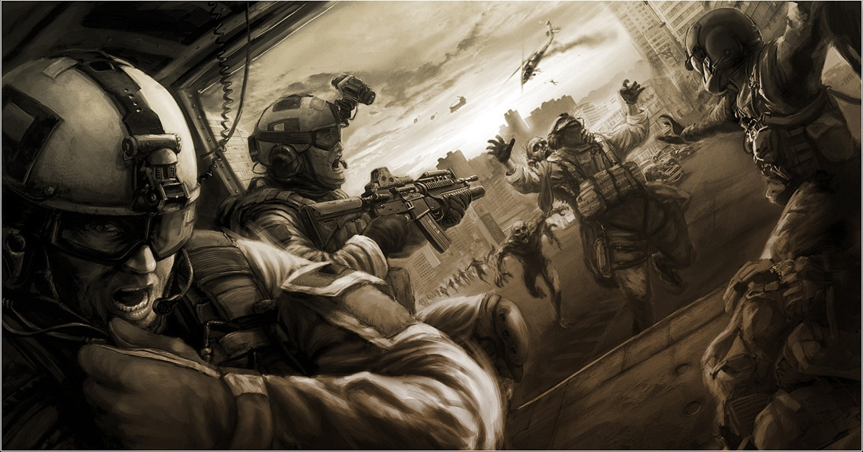
Humans vs. Zombies
After reading Todd Wanio’s account of the Battle of Yonkers, how well do you think our military, in its current state, would fare against a massive zombie horde?

Slide 6
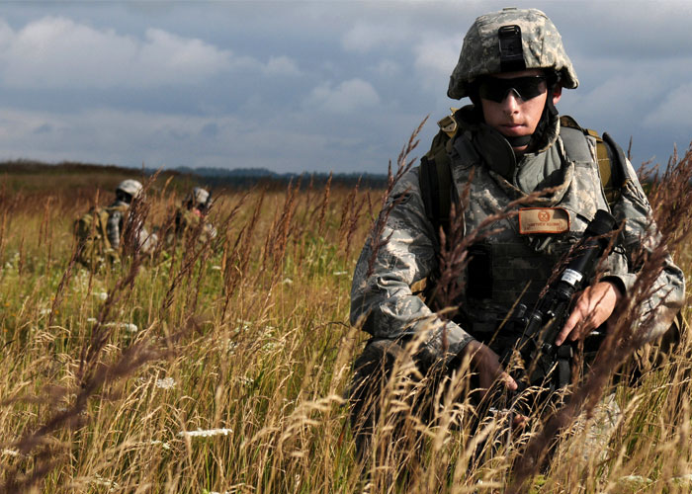
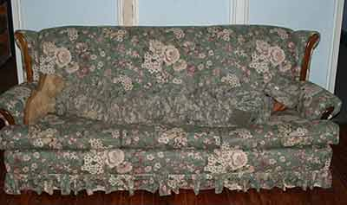
Wasted spending
UCP, the camouflage developed for the Army during Operation: Iraqi Freedom, cost an estimated $5 billion to develop and distribute to US forces. As you can see, it doesn’t work too well.

Slide 7
Army spends $100m on piece of equipment that doesn’t do anything
Verbal Irony – Proud to acquire a piece of crap
Situational Irony – Need to spend money, build something worthless.
Understatement – Feedback from soldiers is “mostly” negative.

Slide 8
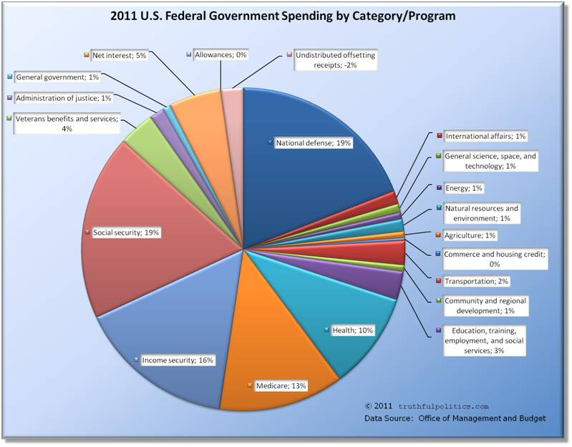

Slide 9
Discussion questions
Is the Department of Defense justified in spending $553,000,000,000 every year?
In your opinion, where if anywhere could this money be better spent?
In what situations could this spending be justified, if any?

Slide 10
Your assignment
In a manner similar to the Duffelblog articles you read before class, compose an article which satirizes the egregious spending of the Department of Defense and / or the military.

Slide 11
Links
BHD:
http://ffilms.org//?s=black+hawk+down
Endor:
https://www.youtube.com/watch?v=mMNINagFe-w

