Slide 1
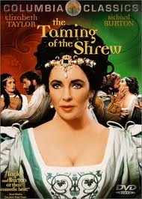
Taming of the Shrew
Nick Schlueter
William Smallwood

Slide 2
Summary
The Taming of the Shrew is a comedy by William Shakespeare.
The play begins with a framing device, known as the Induction, in which a mischievous nobleman tricks a drunken tinker named Christopher Sly into believing he is actually a nobleman himself. The nobleman then has the play performed.
The main plot depicts the courtship of Petruchio, a gentleman of Verona, and Katherina, the headstrong, obdurate shrew. Katherina’s father wants Petruchio to woo Katherina so she may be married. Initially, Katherina is an unwilling participant in the relationship, but Petruchio tempers her with various psychological torments—the "taming"—until she becomes a compliant and obedient bride.

Slide 3
Video
www.youtube.com/watch?v=O9UpVrNTErY
‎

Slide 4
THE TEXT
Good morrow, Kate; for that's your name, I hear.
KATHARINA
Well have you heard, but something hard of hearing: They call me Katharina that do talk of me.
PETRUCHIO
You lie, in faith; for you are call'd plain Kate, And bonny Kate and sometimes Kate the curst; But Kate, the prettiest Kate in Christendom Kate of Kate Hall, my super-dainty Kate, For dainties are all Kates, and therefore, Kate, Take this of me, Kate of my consolation; Hearing thy mildness praised in every town, Thy virtues spoke of, and thy beauty sounded, Yet not so deeply as to thee belongs, Myself am moved to woo thee for my wife.
KATHARINA
Moved! in good time: let him that moved you hither Remove you hence: I knew you at the first You were a moveable.
PETRUCHIO
Why, what's a moveable?
KATHARINA
A join'd-stool.
PETRUCHIO
Thou hast hit it: come, sit on me.
KATHARINA
Asses are made to bear, and so are you.
PETRUCHIO
Women are made to bear, and so are you.
KATHARINA
No such jade as you, if me you mean.
PETRUCHIO
Alas! good Kate, I will not burden thee; For, knowing thee to be but young and light--
KATHARINA
Too light for such a swain as you to catch; And yet as heavy as my weight should be.
PETRUCHIO
Should be! should--buzz!
KATHARINA
Well ta'en, and like a buzzard.
PETRUCHIO
O slow-wing'd turtle! shall a buzzard take thee?
KATHARINA
Ay, for a turtle, as he takes a buzzard.
PETRUCHIO
Come, come, you wasp; i' faith, you are too angry.
KATHARINA
If I be waspish, best beware my sting.
PETRUCHIO
My remedy is then, to pluck it out.
KATHARINA
Ay, if the fool could find it where it lies,
PETRUCHIO
Who knows not where a wasp does wear his sting? In his tail.
KATHARINA
In his tongue.
PETRUCHIO
Whose tongue?
KATHARINA
Yours, if you talk of tails: and so farewell.
PETRUCHIO
What, with my tongue in your tail? nay, come again, Good Kate; I am a gentleman.
KATHARINA
That I'll try.
She strikes him

Slide 5
PETRUCHIO
I swear I'll cuff you, if you strike again.
KATHARINA
So may you lose your arms: If you strike me, you are no gentleman; And if no gentleman, why then no arms.
PETRUCHIO
A herald, Kate? O, put me in thy books!
KATHARINA
What is your crest? a coxcomb?
PETRUCHIO
A combless cock, so Kate will be my hen.
KATHARINA
No cock of mine; you crow too like a craven.
PETRUCHIO
Nay, come, Kate, come; you must not look so sour.
KATHARINA
It is my fashion, when I see a crab.
PETRUCHIO
Why, here's no crab; and therefore look not sour.
KATHARINA
There is, there is.
PETRUCHIO
Then show it me.
KATHARINA
Had I a glass, I would.
PETRUCHIO
What, you mean my face?
KATHARINA
Well aim'd of such a young one.
PETRUCHIO
Now, by Saint George, I am too young for you.
KATHARINA
Yet you are wither'd.
PETRUCHIO
'Tis with cares.
KATHARINA
I care not.
PETRUCHIO
Nay, hear you, Kate: in sooth you scape not so.
KATHARINA
I chafe you, if I tarry: let me go.
PETRUCHIO
No, not a whit: I find you passing gentle. 'Twas told me you were rough and coy and sullen, And now I find report a very liar; For thou are pleasant, gamesome, passing courteous, But slow in speech, yet sweet as spring-time flowers: Thou canst not frown, thou canst not look askance, Nor bite the lip, as angry wenches will, Nor hast thou pleasure to be cross in talk, But thou with mildness entertain'st thy wooers, With gentle conference, soft and affable. Why does the world report that Kate doth limp? O slanderous world! Kate like the hazel-twig Is straight and slender and as brown in hue As hazel nuts and sweeter than the kernels. O, let me see thee walk: thou dost not halt.
KATHARINA
Go, fool, and whom thou keep'st command.
PETRUCHIO
Did ever Dian so become a grove As Kate this chamber with her princely gait? O, be thou Dian, and let her be Kate; And then let Kate be chaste and Dian sportful!
KATHARINA
Where did you study all this goodly speech?
PETRUCHIO
It is extempore, from my mother-wit.
KATHARINA
A witty mother! witless else her son.
PETRUCHIO
Am I not wise?
KATHARINA
Yes; keep you warm.
PETRUCHIO
Marry, so I mean, sweet Katharina, in thy bed: And therefore, setting all this chat aside, Thus in plain terms: your father hath consented That you shall be my wife; your dowry 'greed on; And, Will you, nill you, I will marry you. Now, Kate, I am a husband for your turn; For, by this light, whereby I see thy beauty, Thy beauty, that doth make me like thee well, Thou must be married to no man but me; For I am he am born to tame you Kate, And bring you from a wild Kate to a Kate Conformable as other household Kates. Here comes your father: never make denial; I must and will have Katharina to my wife.

Slide 6
SOAPS Petruchio
Speaker - trying to tame, persistent
Occasion- wants to marry a wealthy woman
Audience- Kate/ 16th century England
Purpose- to woo
Situation- context of the play

Slide 7
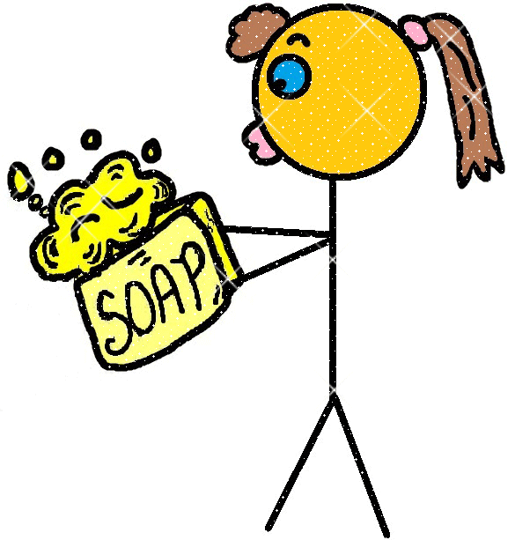
SOAPS Kate
Speaker– no taming, resist wooing, the shrew
Occasion – her father wants
Audience – Petruchio/16th century England
Purpose – to deny/ to humor
Situation – context of play

Slide 8
Logos, Ethos, Pathos

Slide 9
Rhetorical devices
Metonymy
Inversion
Zeugma
Sexual references
Satire
Antimetabole
Antithesis
Anaphora

Slide 10
Petruchio
Playful
Flirty
Humorous
Civilized
Cocky
Persuasive

Slide 11
Kate
Sarcastic
Witty
Hard-to-get
Flirty
She’s giving him attitude

