Slide 1
Get to Writing!
List 10-15 items that you would consider to be your most frequently used items on a day to day basis
Five minutes
Preferably items that you could carry in your hands/arms
No cars, school, or house, etc.

Slide 2
Lost at Sea!
You are adrift on a private yacht in the South Pacific. As a consequence of a fire of unknown origin, much of the yacht and its contents have been destroyed. The yacht is now slowly sinking. Your location is unclear because of the destruction of critical navigational equipment and because you and the crew were distracted trying to bring the fire under control. Your best estimate is that you are approximately one thousand miles south-southwest of the nearest land.
Below is a list of fifteen items that are intact and undamaged after the fire. In addition to these articles, you have a serviceable, rubber life raft with oars large enough to carry yourself, the crew, and all the items listed below. The total contents of all survivors’ pockets are a package of cigarettes, several books of matches, and five one-dollar bills.
Your task is to rank the fifteen items below in terms of their importance to your survival. Place the number 1 by the most important item, the number 2 by the second most important, and so on through number 15, the least important.

Slide 3
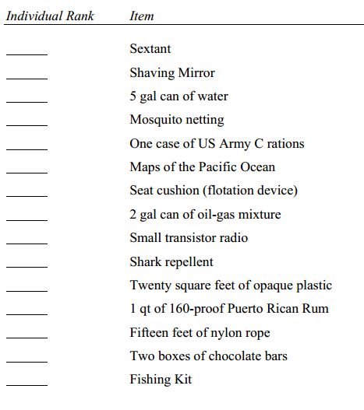
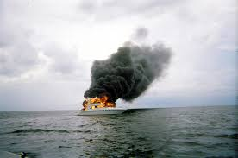
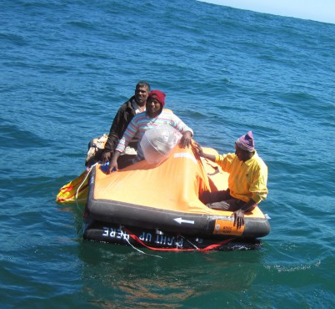

Slide 4
Who would survive?
What is your number 1 item?
Your number 15?
Debate!
Check results

Slide 5
Survival Expert List & Rationale
Shaving mirror: critical for signaling air rescue
Two-gallon can of oil/gas mixture: critical for signaling; can float on water and ignite with a dollar and a match
Five-gallon can of water: necessary for rehydration
US Army C rations: basic food intake
20 sq. ft. of plastic: utilized to collect rain water; shelter from elements
Chocolate bars: reserve food source
Fishing kit: “one bird in hand..” no guarantee to catch anything
Nylon rope: can lash equipment together to keep from falling overboard
Floating cushion: rescue device if someone fell overboard
Shark repellent: obvious
160-pf Rum: possible antiseptic; will cause dehydration if ingested
Transistor radio: of little use, our of range of transmitters
Maps of Pacific: useless without navigation equipment
Mosquito netting: no mosquitoes in mid-Pacific
Sextant: without tables and chronometer, useless

Slide 6
A Walk in the Woods, Bill Bryson
Main Focus: Bryson talking about buying his equipment
What is he really saying?
Tone?
Diction?
Satirical/rhetorical devices?
Examples
Our examples
Understatement: “It seemed to me a trifle overfastidious to choose one sleeping bag over another because it weighed three ounces less…” (12)
Sarcasm: “Does it have a bottom in it?” (14)
Hyperbole: “I ended up with enough equipment to bring full employment to a vale of sherpas…” (14)

Slide 7
Writing Again
Writing assignment:
Using your list of most frequently used items, and Bryson’s tone (comical/cynical), write about your family preparing to head north during the “Great Panic” (like Jesika Hendricks). Either take note of items your family brought that were unnecessary, or items that another family brought that were unnecessary.
Don’t forget to use your list!
Consider using the following satirical devices
Sarcasm
Hyperbole/overstatement
Litotes/understatement
Farce
Oxymoron
Repartee
Paralipsis
Caricature
Euphemism

Slide 8
Example
Mom just simply insisted that Dad and I grab the grandfather clock, and load it on top of the car. I’m really glad that we spent the extra 37 minutes that we could have been escaping picking it up, carrying from room to room and out the door, then lifting on top of the car! I wouldn’t want our ancestors, after passing the clock from generation to generation, to die at the hands of the zombies apocalypse too. Although it was extremely heavy, not in the least bit agile, and completely unable to tell time, if there were two or three zombies that just happened to be laying down in a line, completely oblivious to our presence, in its shadow, that thing could easily be pushed over and gain itself a nice triple-kill. And maybe some day it would make a lovely piece of decorative firewood! Don’t know what we would have done without the clock!

Slide 9
World War Z, Max Brooks
Main Focus: satire on what is important in life (especially to survive)
Compare/contrast his satire to Bryson’s views
Tone is everything!
Examples
Jesika Hendricks
Arthur Sinclair
Roy Elliot
Todd Wanio
Christina Eliopis
Fernando Olivero

Slide 10
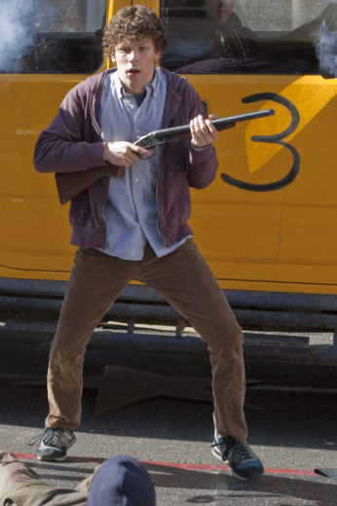
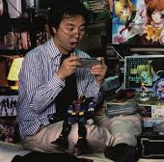
Side Note: Tone is EVERYTHING
Take the same character in different tones
Columbus, Zombieland vs. Kondo Tatsumi, WWZ
Tech savvy
Shut-in, antisocial offline
Un-athletic
Has a crush on an attractive neighbor but never talks to her
Estranged towards parents
Meet zombies in comfort of their own apartments
Narrowly escape first confrontation
Meet up with a zombie killing master driven by personal tragedy
End story and heroes/survivors
Difference
Columbus, in a comical tone, wins over the girl and is on top of the world at the end
Kondo, in a serious tone, is humbled and works in a monastery to protect people

Slide 11
Jesika Hendricks (123)
[She shows me something in the ice, a collection of cracked CDs]
This is what people brought with them: hair dryers, GameCubes, laptops by the dozen. I don’t think they were stupid enough to think they could use them. Maybe some did. I think most people were just afraid of losing them, that they’d come home after six months and find their homes looted. We actually thought we were packing sensibly. Warm clothes, cooking utensils, things from the medicine cabinet, and all the canned food we could carry. It looked like enough for a couple years. We finished half of it on the way up. That didn’t bother me. It was like an adventure, the trek north.
Note:
Tone
Devices
Satire

Slide 12
Jesika Henricks (126)
But once the dead were frozen, how were you going to survive the winter?
Good question. I don’t think most people thought that far ahead. Maybe they figured that the “authorities” would come rescue us or that they could just pack up and head home. I’m sure a lot of people didn’t think about anything except the day in front of them, just grateful that they were finally safe and confident that things would work themselves out. “We’ll all be home before you know it,” people would say. “It’ll be over by Christmas.”
[She draws my attention to another object in the ice, a Spongebob Squarepants sleeping bag. It is small, and stained brown.]
What do you think this is rated to, a heated bedroom at a sleepover party? Okay, maybe they couldn’t get a proper bag – camping stored were always the first bought out or knocked off – but you can’t believe how ignorant some of these people were. A lot of them were from Sunbelt states, some as far away as southern Mexico. You’d see people getting into their sleeping bags with their boots on, not realizing that it was cutting off their circulation. You’d see them drinking to get warm, not realizing it was actually lowering their body temperature by releasing more body heat. You’d see them wearing these big heavy coats with nothing but a T-shirt underneath. They’d do something physical, overheat, take off the coat. Their bodies’d be coated in sweat, a lot of cotton cloth holding in the moisture. The breeze’d come up… a lot of people got sick that first September. Cold and flu. They gave it to the rest of us.

Slide 13
Arthur Sinclair (137-146)
Director of DeStRes (created to solve problems within safe zone)
138-139: “The first labor survey stated clearly that over 65 percent of the present civilian workforce were classified F-6, possessing no valued vocation.”
140-141: “At first I thought this woman was being rude, degrading the instructor by refusing to use her title. I found out later that Mrs. Magda Antonova used to be this woman’s cleaning lady.”
Truly important skills are overlooked too
Survival calls for different skill sets

Slide 14
Roy Elliot (159-168)
Director of propaganda films
159: “It was helplessness, or at least, the perception of helplessness. I understood that feeling. I directed movies all my adult life. They called me the boy genius. The wunderkid who couldn’t fail, even though I’d done so often.”
160: “Suddenly I was a nobody, an F-6. The world was going to hell and all my vaunted talents were powerless to stop it.”
His tone is helpless (just like ADS, the mental disease he fought)
Went from top of the world to nothing
Important skills

Slide 15
Todd Wanio (92-104, 315-327)
Soldier; fought in Yonkers and in the retaking battles
In his first section, he gives countless examples of ineffective methods to fight zombies
MOPP4
Projectile explosives
Land Warrior
Armor piercing rounds
In his second section he talks about the effective ways to fight zombies
BDUs
Cherry PIE rounds
Box formation
Simplicity and continuity were key

Slide 16
Christina Eliopis (168-186)
Crashed pilot who made her way through southern swampland to safety
179: “That hit me hard, a lot harder than the little faceless kid. This guy had everything he needed to survive, everything except the will. I know that’s supposition. Maybe there was a wound I couldn’t see, hidden by his clothes or the advanced decomposition. But I knew it, leaning there with my face against the glass, looking at this monument to how easy it was to give up.”
Materials are the only necessities to survive
Mindset can be better than equipment

Slide 17
Fernando Olivero (21-28)
Brazilian doctor taking refuge in the Amazon
21: “[I arrive blindfolded, so as not to reveal my ‘hosts’’ location. Outsiders call them the Yanomami, ‘The Fierce People,’ and it is unknown whether their supposedly warlike nature or the fact that their village hangs suspended from the tallest trees was what allowed them to weather the crisis as well, if not better, than even the most industrialized nation.…]”
A primitive jungle tribe survived the war
Keys:
Primitiveness
Simplicity
Bare necessities

Slide 18
Panic vs. Preparedness
The context of a situation creates tone
Both A Walk in the Woods and World War Z deal with survival situations, and gathering what is important to survive (and life in general)
Bryson’s tone is created by his “preparedness”
He has excess and unnecessary/wrong equipment
Since he is prepared, however, he can approach it with comedy
Brooks' tone is created by the panic present in his characters
They were unprepared, and thus panicked (hence, “The Great Panic”)
Their tone is more serious, even reaching helpless
Each provides a commentary to what is truly important in life

Slide 19
Continued
The panic vs. preparedness issue can deem to a person what is actually important
Panicked people are likely to take the wrong things
Prepared people are likely to take too much
Panicked people will save material items (heirlooms, prized possessions, etc.) in dire situations
Prepared people will save supplies (water, food, survival items) in dire situations
Panicked people will act on basic primal instincts
Prepared people could have a false sense of security
The point of satire?
Brooks displays what people think is important, and how it could hurt or help them
The satire calls us to evaluate that in our own lives
What do we really need in life?

Slide 20
Citations
Brooks, Max. World War Z. London: Duckworth, 2007. Print.
Brooks, Max. The Zombie Survival Guide: Complete Protection from the Living Dead. New York: Three Rivers, 2003. Print.
Bryson, Bill. A Walk in the Woods. London: Doubleday, 1997. Print.
"Lost at Sea Survival Test." Leadership Center at Washington State University, n.d. Web. 25 Jan. 2014. http://dsa.csupomona.edu/osl/studentmanual/files/Lost _At_Sea_327.pdf
Zombieland. Dir. Ruben Fleischer. Perf. Jesse Eisenberg, Emma Stone, Woody Harrelson. Sony Pictures Home Entertainment, 2009.

