Slide 1
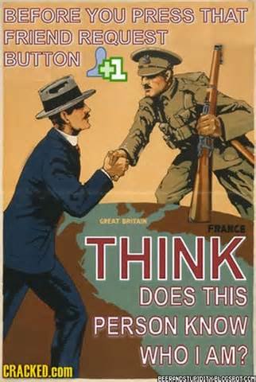
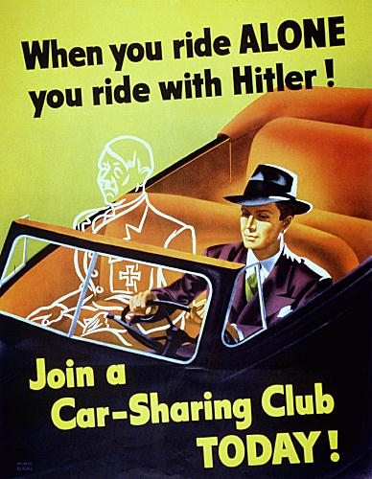
Propaganda
Nick Reed, Tyler Schumacher, Jack Kunkel, Scott Rumsey

Slide 2
Opening Writing Assignment
Pick any product to sell or idea to promote
Try to promote/sell by only using logical reason (facts)
Example: The new Juicer 2000 can juice fruits and vegetables by removing 91% of all juice from your fruits and vegetables. It removes the juice approximately 4:37 faster than if you juice by hand. The Juicer 2000 only requires 270N of force to operate as well. It also cost three payments of $19.95. Buy a Juicer 2000 today!

Slide 3
General Definition
information, ideas, or rumors deliberately spread widely to help or harm a person, group, movement, institution, nation, etc.
the deliberate spreading of such information, rumors, etc.
the particular doctrines or principles propagated by an organization or movement.

Slide 4
Basic Psychology of Propaganda
Central Route Persuasion vs. Peripheral Route Persuasion
Elaboration likelihood model of persuasion (ELM)
Richard E. Petty and John Cacioppo
Deals with the spectrum of fact versus emotion
Situation dictates where on the spectrum your argument should lie
A propagandist’s situation leads towards more peripheral route persuasion (pathos)

Slide 5
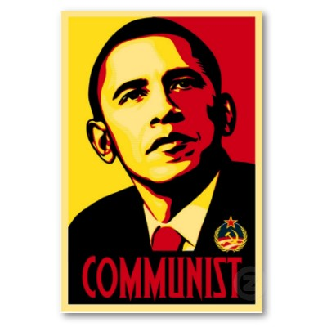
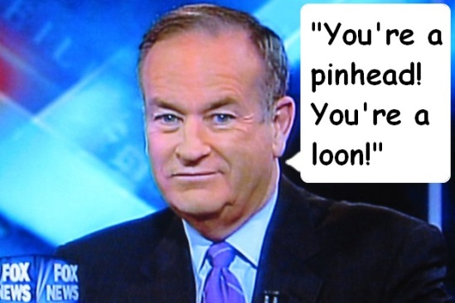
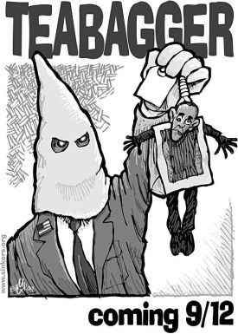
Characteristics
Name Calling- Giving “bad-names” to groups or individuals to sway us against them
Card-stacking- telling only the part of the story that promotes the message the speaker is sending.“ Stacking the cards against the truth”

Slide 6
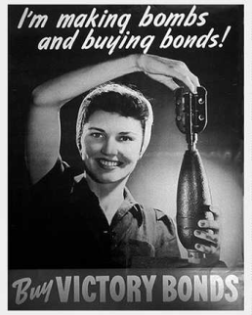
Glittering Generalities- Appeals to our emotions of love, generosity, and brotherhood
Plain-folks- When a speaker tries to win ones confidence by seeming just like us/appealing to our experiences
band-wagon- Device used to try and get us to “follow the crowd”

Slide 7
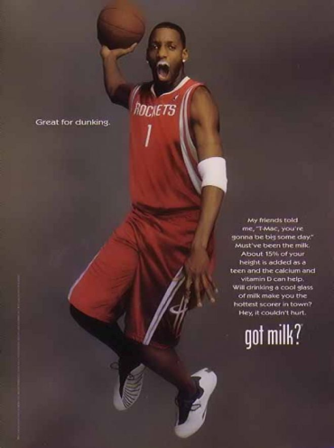
Transfer- Carrying over the authority of something we respect to something the author wants us to accept.
Testimonials- Having someone speak on behalf of the product

Slide 8
Examples
Watch the following videos and label which type of propaganda each is:
http://www.youtube.com/watch?v=sJSimKDRU7Q
http://www.youtube.com/watch?v=9gspElv1yvc
http://www.youtube.com/watch?v=K7L5QByvXOQ

Slide 9
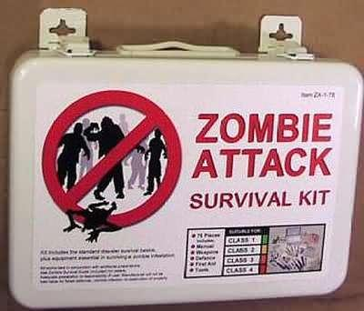
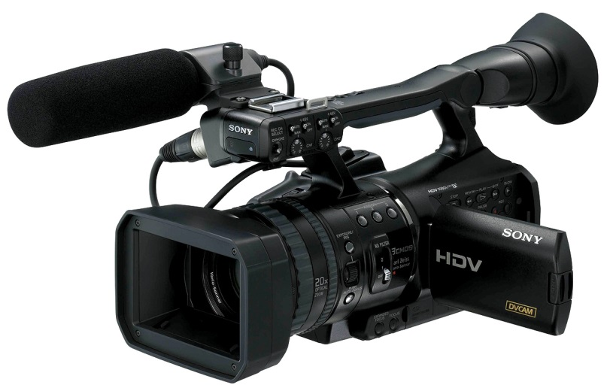
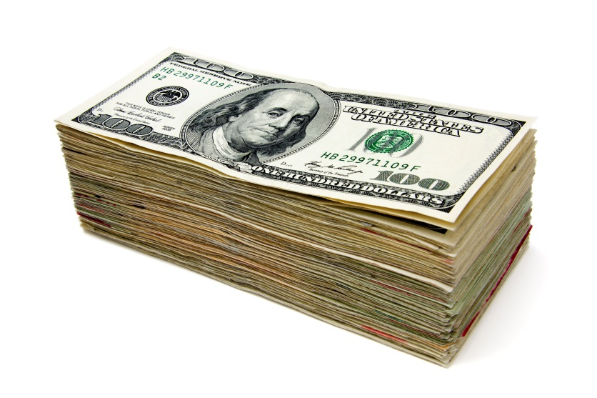
WWZ Propaganda
Breckenridge and Elliott
Identify heavily connoted tone words in each of the following excerpts

Slide 10
Breckinridge Scott
“People are selling the fear of you having to live without their products”.
“Fear is the most basic emotion we have. Fear is primal. Fear sells. That was my mantra: “Fear Sells”.”
“You know how many people made money on these scares? Shit, I made my first million on useless anti-radiation pills during the dirty bomb scares.”
“That guy in Florida who said he’d been bitten but survived because he was taking Phalanx? OH! [He stands, mimes the act of frantic fortification.] God freakin’ bless that dumbass, whoever he was
“Shit, you wanna blame someone, why not start with all the sheep who forked over their greenbacks without bothering to do a little responsible research. I never held a gun to their heads. They made the choice themselves. They’re the bad guys, not me. I never directly hurt anybody, and if anybody was stupid enough to get themselves hurt, boo-fuckin-hoo.

Slide 11
Breckinridge Scott
“People are selling the fear of you having to live without their products”.
“Fear is the most basic emotion we have. Fear is primal. Fear sells. That was my mantra: “Fear Sells”.”
“You know how many people made money on these scares? Shit, I made my first million on useless anti-radiation pills during the dirty bomb scares.”
“That guy in Florida who said he’d been bitten but survived because he was taking Phalanx? OH! [He stands, mimes the act of frantic fortification.] God freakin’ bless that dumbass, whoever he was.
“Shit, you wanna blame someone, why not start with all the sheep who forked over their greenbacks without bothering to do a little responsible research. I never held a gun to their heads. They made the choice themselves. They’re the bad guys, not me. I never directly hurt anybody, and if anybody was stupid enough to get themselves hurt, boo-fuckin-hoo.

Slide 12
Roy Elliot
“The point is it worked. It made a difference, and it gave me a job for the rest of the war.”
“But it didn’t matter. The movie was such a hit that I was asked to do a whole series. I called it “Wonder Weapons,” seven films on our military’s cutting edge technology, none of which made any strategic difference, but all were psychological war winners.”
“A lie? It’s okay. You can say it. Yes, there were lies and sometimes that’s not a bad thing. Lies are neither bad nor good. Like a fire they can keep you warm or burn you to death, depending on how they’re used.”
“There’s a word for that kind of lie. Hope.”

Slide 13
Roy Elliot
“The point is it worked. It made a difference, and it gave me a job for the rest of the war.”
“But it didn’t matter. The movie was such a hit that I was asked to do a whole series. I called it “Wonder Weapons,” seven films on our military’s cutting edge technology, none of which made any strategic difference, but all were psychological war winners.”
“A lie? It’s okay. You can say it. Yes, there were lies and sometimes that’s not a bad thing. Lies are neither bad nor good. Like a fire they can keep you warm or burn you to death, depending on how they’re used.”
“There’s a word for that kind of lie. Hope.”

Slide 14
The contrast
What are the differences in Elliot and Scott’s tones and ways of speaking?
How does the public perception of them vary?
Think of Roy Elliot’s allusion to The Hero City and his fellow filmmaker, Marty.
“that was our reality and it’s what drove so many people to get snuggled in bed, blow out their candles, and take their last breath. Marty chose, instead, to show the other side, the one that gets people out of bed the next morning” (167-168).
Why is this propaganda accepted by the people?
What was different about what Elliot and Scott did? Was there a difference at all?
Is it sometimes okay to sell false hope or to simply lie using propaganda?

Slide 15
Family Guy’s take on Propaganda
http://www.youtube.com/watch?v=0YOh-rpvjYg
What type of words, sentences, and phrases does Lois use to sway the audience to her side?
What commentary does this make about persuasion of the masses (and the intelligence of the masses)?

Slide 16
The Language of Propaganda
“Fear is the most basic emotion we have. Fear is primal. Fear sells. That was my mantra: ‘Fear sells’”.
“Shit, you wanna blame someone, why not start with all the sheep who forked over their greenbacks without bothering to do a little responsible research?”
Is this message consistent with Family Guy’s view of humanity?
Given his words to the narrator, what type of language would you imagine Scott relies on in advertising?

Slide 17
“The poster campaign showed a zombie being atomized. The image was lifted right from a frame in the movie, the one classic shot where the morning fog actually allowed you to see the beam. The caption underneath simply read ‘Next’. It singlehandedly saved the [weapons] program”.
What route to persuasion does Elliot use?
Imagine the image he refers to. What are its characteristics? Artistic and thought-provoking, or flashy and simple?
In the propaganda you see in your life, how does the propagandist address the audience?

Slide 18
Final Writing Assignment
Take your product/idea from your first writing assignment
Now sell/promote using a parody of propaganda
Make it extreme
Example: The new Juicer 2000 is the supreme fruit and vegetable juicer. It is easy to use for those who have the muscles of a twig. You can juice the fruit fast so you can get on with your useless life! It costs $59.85, but we break it into three payments so it seems like a bargain! Call right now and we will double your offer so you can have double the crap! *Must pay separate shipping and handling (Call 1-800-56J-UICE)

Slide 19
Works Cited
"Central and Peripheral Routes to Persuasion." Psychology and Society. N.p., n.d. Web. 22 Feb. 2014.
"Elaboration Likelihood Model." ChangingMinds.org. N.p., n.d. Web. 22 Feb. 2014.
Shea, Renee H., and Lawrenc Scanlon. The Language of Composition: Reading, Writing, Rhetoric. S.l.: Bedford, Freeman & Worth Pub., 2008. Print
. "Propaganda by Edward Bernays (1928)." Propaganda by Edward Bernays (1928). N.p., n.d. Web. 24 Feb. 2014. <http://www.historyisaweapon.com/defcon1/bernprop.html>.
"Propaganda." Dictionary.com. Dictionary.com, n.d. Web. 23 Feb. 2014. <http://dictionary.reference.com/browse/propaganda>.
"World War II Propaganda, Cartoons, Film, Music, & Art." WWII Propaganda, Images, Art. N.p., n.d. Web. 25 Feb. 2014. <http://www.teacheroz.com/WWIIpropaganda.htm>.

