Slide 1
Taming of the Shrew
Kate and Petruchio meet
Nick Reed, Tyler Schumacher, Jack Kunkel
@Fat
@Schudaddy
@UncleKunkel

Slide 2
Play Summary
Frame narrative
A peasant man name Christopher Sly gets extremely drunk
A local lord has his men take Sly back to his manor
The lord and his men tell Sly that he is a lord and has only thought otherwise because he is insane
They say that a troupe of actors has prepared a show for him
The bulk of Taming of the Shrew is the play that Sly watches

Slide 3
A young man named Lucentio goes to Padua to attend school
He falls in love with a woman named Bianca
Bianca has two suitors already, but even worse, her father will not let her marry until her older sister Katarina gets married
Lucentio’s friend Petruchio arrives in Padua and wants to find a rich woman
He agrees to court Katarina to help Lucentio
Katarina and Petruchio meet and have a battle of wits
This is the scene we will study

Slide 4
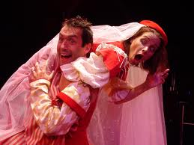
Katarina is tricked into marrying Petruchio
Petruchio does not show up on his wedding day
After the wedding, Petruchio “tames” Katarina
Deprives her of sleep and food
Tries to make her an obedient wife
Eventually has total control over her
Lucentio wins Bianca over
The three new husbands- Petruchio, Lucentio, and Vincentio- have a competition over whose wife is most obedient
Shockingly, Petruchio wins- Katarina has been “tamed”

Slide 5
Discussion Question
Why the frame narrative?

Slide 7
Discussion Question #2
Is this play sexist?

Slide 8
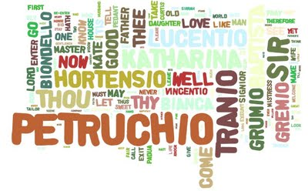
Subject
This is the first meeting of Kate and Petruchio who, as discussed earlier, will wed by the end of the play
The conversation itself is a battle of wits

Slide 9
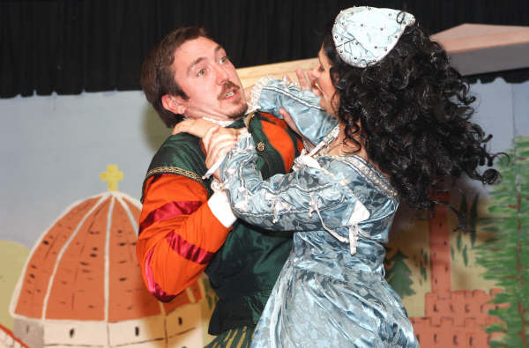
Occasion
First time Kate and Petruchio have seen one another
Petruchio decided he would marry Kate before he ever met her

Slide 10
Audience/speakers
Kate
She is a shrew. No one likes her because she is unpleasant
Intelligent, witty (match with Petruchio)
Historically resistant to men
Petruchio
Decided prior to visit that he will marry her
Wants to marry her for money (initially)
Doesn’t truly care/ lies to flatter her

Slide 11
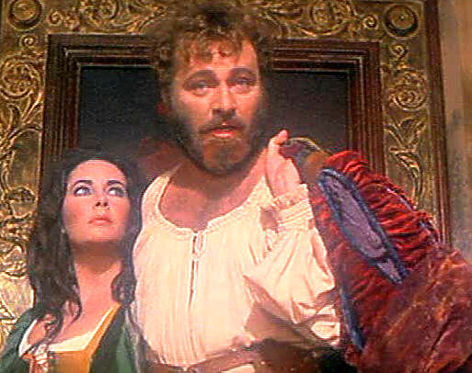
Purpose
Kate and Petruchio speak to each other
Petruchio is trying to woo Kate
Kate is trying to turn Petruchio away

Slide 12
Video
http://www.youtube.com/watch?v=RdqOHvcD-VU

Slide 13
The scene
PETRUCHIO 168 I pray you do.
Exeunt [all but] Petruchio.
168 I will attend her here, 169 And woo her with some spirit when she comes. 170 Say that she rail; why then I'll tell her plain 171 She sings as sweetly as a nightingale: 172 Say that she frown, I'll say she looks as clear 173 As morning roses newly wash'd with dew: 174 Say she be mute and will not speak a word; 175 Then I'll commend her volubility, 176 And say she uttereth piercing eloquence: 177 If she do bid me pack, I'll give her thanks, 178 As though she bid me stay by her a week: 179 If she deny to wed, I'll crave the day 180 When I shall ask the banns and when be married. 181 But here she comes; and now, Petruchio, speak. Enter KATHARINA.
182 Good morrow, Kate; for that's your name, I hear. KATHARINA 183 Well have you heard, but something hard of hearing: 184 They call me Katharina that do talk of me.
PETRUCHIO 185 You lie, in faith; for you are call'd plain Kate, 186 And bonny Kate and sometimes Kate the curst; 187 But Kate, the prettiest Kate in Christendom 188 Kate of Kate Hall, my super-dainty Kate, 189 For dainties are all Kates, and therefore, Kate, 190 Take this of me, Kate of my consolation; 191 Hearing thy mildness praised in every town, 192 Thy virtues spoke of, and thy beauty sounded, 193 Yet not so deeply as to thee belongs, 194 Myself am moved to woo thee for my wife.
KATHARINA 195 Moved! in good time: let him that moved you hither 196 Remove you hence: I knew you at the first 197 You were a moveable.
PETRUCHIO 197 Why, what's a moveable?
KATHARINA 198 A join'd-stool.
PETRUCHIO 198 Thou hast hit it: come, sit on me.
KATHARINA 199 Asses are made to bear, and so are you.
PETRUCHIO 200 Women are made to bear, and so are you.

Slide 14
KATHARINA 201 No such jade as you, if me you mean.
PETRUCHIO 202 Alas! good Kate, I will not burden thee; 203 For, knowing thee to be but young and light—
KATHARINA 204 Too light for such a swain as you to catch; 205 And yet as heavy as my weight should be.
PETRUCHIO 206 Should be! should—buzz!
KATHARINA 206 Well ta'en, and like a buzzard.
PETRUCHIO 207 O slow-wing'd turtle! shall a buzzard take thee?
KATHARINA 208 Ay, for a turtle, as he takes a buzzard.
PETRUCHIO 209 Come, come, you wasp; i' faith, you are too angry.
KATHARINA 210 If I be waspish, best beware my sting.
PETRUCHIO 211 My remedy is then to pluck it out.
KATHARINA 212 Ay, if the fool could find it where it lies,
PETRUCHIO 213 Who knows not where a wasp does 214 wear his sting? In his tail.

Slide 15
KATHARINA 215 In his tongue.
PETRUCHIO 216 Whose tongue?
KATHARINA 217 Yours, if you talk of tails: and so farewell.
PETRUCHIO 218 What, with my tongue in your tail? nay, come again, 219 Good Kate; I am a gentleman—
KATHARINA 219 That I'll try.
She strikes him.
PETRUCHIO 220 I swear I'll cuff you, if you strike again.
KATHARINA 221 So may you lose your arms: 222 If you strike me, you are no gentleman; 223 And if no gentleman, why then no arms.
PETRUCHIO 224 A herald, Kate? O, put me in thy books!
KATHARINA 225 What is your crest? a coxcomb?
PETRUCHIO 226 A combless cock, so Kate will be my hen.
KATHARINA 227 No cock of mine; you crow too like a craven.
PETRUCHIO 228 Nay, come, Kate, come; you must not look so sour.
KATHARINA 229 It is my fashion, when I see a crab.
PETRUCHIO 230 Why, here's no crab; and therefore look not sour.
KATHARINA 231 There is, there is.
PETRUCHIO 232 Then show it me.

Slide 16
PETRUCHIO 242 No, not a whit: I find you passing gentle. 243 'Twas told me you were rough and coy and sullen, 244 And now I find report a very liar; 245 For thou are pleasant, gamesome, passing courteous, 246 But slow in speech, yet sweet as spring-time flowers: 247 Thou canst not frown, thou canst not look askance, 248 Nor bite the lip, as angry wenches will, 249 Nor hast thou pleasure to be cross in talk, 250 But thou with mildness entertain'st thy wooers, 251 With gentle conference, soft and affable. 252 Why does the world report that Kate doth limp? 253 O slanderous world! Kate like the hazel-twig 254 Is straight and slender and as brown in hue 255 As hazel nuts and sweeter than the kernels. 256 O, let me see thee walk: thou dost not halt.
KATHARINA 257 Go, fool, and whom thou keep'st command.
PETRUCHIO 258 Did ever Dian so become a grove 259 As Kate this chamber with her princely gait? 260 O, be thou Dian, and let her be Kate; 261 And then let Kate be chaste and Dian sportful!
KATHARINA 262 Where did you study all this goodly speech?
KATHARINA 233 Had I a glass, I would.
PETRUCHIO 234 What, you mean my face?
KATHARINA 235 Well aim'd of such a young one.
PETRUCHIO 236 Now, by Saint George, I am too young for you.
KATHARINA 237 Yet you are wither'd.
PETRUCHIO 238 'Tis with cares.
KATHARINA 239 I care not.
PETRUCHIO 240 Nay, hear you, Kate: in sooth you scape not so.
KATHARINA 241 I chafe you, if I tarry: let me go.

Slide 17
PETRUCHIO 263 It is extempore, from my mother-wit.
KATHARINA 264 A witty mother! witless else her son.
PETRUCHIO 265 Am I not wise?
KATHARINA 266 Yes; keep you warm.
PETRUCHIO 267 Marry, so I mean, sweet Katharina, in thy bed: 268 And therefore, setting all this chat aside, 269 Thus in plain terms: your father hath consented 270 That you shall be my wife; your dowry 'greed on; 271 And, Will you, nill you, I will marry you. 272 Now, Kate, I am a husband for your turn; 273 For, by this light, whereby I see thy beauty, 274 Thy beauty, that doth make me like thee well, 275 Thou must be married to no man but me; 276 For I am he am born to tame you Kate, 277 And bring you from a wild Kate to a Kate 278 Conformable as other household Kates. 279 Here comes your father: never make denial; 280 I must and will have Katharina to my wife.

Slide 18
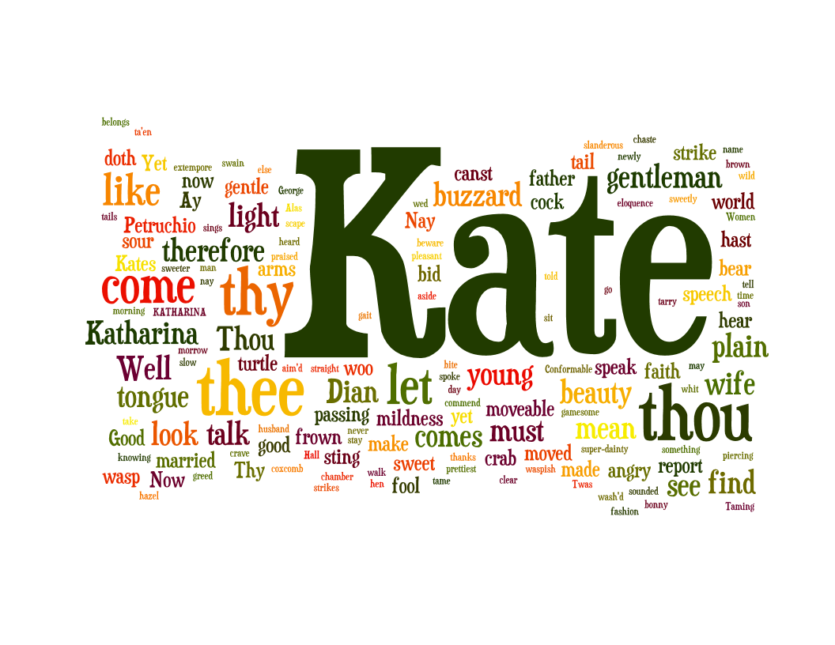

Slide 19
Tone of speakers
The scene is a comedy- both speakers are being facetious and mocking
Notice how quickly the lines are said in the video
There is a slightly detectable bit of mutual respect as the scene continues

Slide 20
Verbal Irony
In this case, Petruchio is lying/attempting to flatter
Obviously lying in order to win her heart
He speaks of Kate’s “virtues” and “mildness”
Soliloquy before she enters
Lines 191-192

Slide 21
Zeugma
Definition- Use of two different words in a gramatically similar way that produces different, incongruous, meanings
Lines 195-197 “moved”
Lines 197-200 “stool”
Lines 225- 227 sexual innuendos
Play on words establishes their wit and biting respect
Adds to the humor

Slide 22
Apostrophe
“O slanderous world!”
Adds dramatic effect of exasperation, adds archaic tone from our perspective

Slide 23
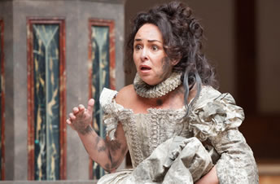
Kate
As seen in the wordle, Katharina’s name being shortened to Kate is very important
Simplified and common
Not sophisticated or elegant
Lines 185-194

Slide 24
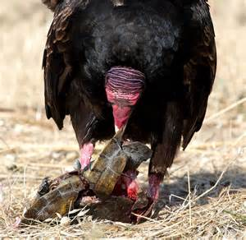
Zoomorphism
Their play on words includes comparisons to animals
Lines 207-210
Calling each other different animals
Wasp- pesky
Turtle- slow (caught by buzzard)

Slide 25
Allusions
Saint George (Line 236)
Name dropping
Was a military saint (depicted as killing a dragon for a lady
Goddess Diana (Lines 258- 261)
Roman mythology Goddess of Hunt
Independent, wild

Slide 26
Works Cited
http://www2.cedarcrest.edu/academic/eng/lfletcher/shrew/efurstnau.htm
http://www.william-shakespeare.info/script-text-taming-of-the-shrew.htm
http://www.shakespeare-online.com/plots/tamingps.html

