Slide 1
Peer Review and the Socratic Seminar: Coordinating a Successful Writing Conference
AP Language and Composition
Moeller Writing Center

Slide 2
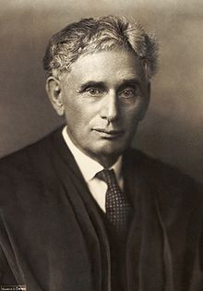
“There is no great writing, only rewriting.”
Justice Louis Brandeis, Supreme Court Justice from 1916 to 1939

Slide 3
Core Ideas of the Writing Conference
A writer-centered ministry: As Marianist as it gets!
Conversation is key
No pitchers of water here…
Individually-oriented aid

Slide 4
Basic Structure of a Writing Conference
GREETINGS!
Show me the assignment…
Establish a plan…
Focus on the text… (Rough draft? “Final” draft?
Wrap it up, give suggestions
Communicate with teacher, student, Mr. Eble
Additional resources…

Slide 5
1. Physical Elements
You’ve got a friend!
Sit side-to-side…
Let the writer own his writing
Pen is mightier with the writer
Text helps with context
Show me the assignment

Slide 6
2. Listen
Let the writer do the talking.
You: “Any specific questions?”
Let the writer do the reading.
Writer: “Oh, that sounds stupid”…
Let the writer do the work
“Write what makes sense to you”

Slide 7
3. What’s the problem?
Focus on a few…
Can’t fix Rome in a day
RELAX A BIT, GRAMMAR NAZI
Common trends versus every problem
Say “I”; “You” can be the dirtiest word in the English language.
Remember—writer-centered
Ask honest questions…
Be brutally, kindly honest

Slide 8
4. Wrap it up!
Summarize Comments:
“Focus on incorporating your research in this draft.”
“Pursue that idea you brought up further and see how it changes your revision.”
Ask/Answer Final Questions:
“Do you feel more confident about tackling this revision now?”
“What about [possible resource]?”

Slide 9
Final Tips from the OWL (Purdue’s Online Writing Lab)
Be a guide, not a ‘guru’: help the student to discover his/her own methods and ideas.
Model, don’t prescribe: demonstrate how to apply something once, then let the student invent on his/her own.
Review and/or refer: let the student leave with a task or a resource so they stay focused beyond their conference.

