Slide 1
Kohlberg’s Moral Development Stages
Mr. Eble
AP language and composition

Slide 2
The Heinz Situation
In Europe, a woman was near death from a special kind of cancer. There was one drug that the doctors thought might save her. It was a form of radium that a druggist in the same town had recently discovered. The drug was expensive to make, but the druggist was charging ten times what the drug cost him to make. He paid $200 for the radium and charged $2,000 for a small dose of the drug. The sick woman's husband, Heinz, went to everyone he knew to borrow the money, but he could only get together about $ 1,000 which is half of what it cost. He told the druggist that his wife was dying and asked him to sell it cheaper or let him pay later. But the druggist said: "No, I discovered the drug and I'm going to make money from it." So Heinz got desperate and broke into the man's store to steal the drug for his wife.
Should the husband have done that? Why or why not?

Slide 3
What is moral development?
According to Laurence Kohlberg (a child psychologist), people go through stages based upon their moral development, or how they make moral decisions.
People progress through them in a linear fashion.
For Kohlberg, actions didn’t matter as much as intentions…his theory concerns moral thinking, not necessarily moral action.

Slide 4
Stage 1: Punishment and Obedience
What is right is literal obedience to rules and authority to avoid punishment
Immediate physical consequences determine whether or not someone does something.
“Heinz should not have stolen the medicine; breaking the law is wrong.”

Slide 5
Stage 1: Punishment, Obedience

Slide 6
Stage 2: Individualism and Exchange
Children recognize that there is not just one right view that is handed down by the authorities. Different individuals have different viewpoints.
What is right is acting on one’s own interests and letting others do the same
It is also what is fair and an agreed-upon, equal deal. (you scratch my back, I’ll scratch yours)
This can also function in a way in which what is right is what satisfies one’s own needs; veangeance is a moral duty.

Slide 7
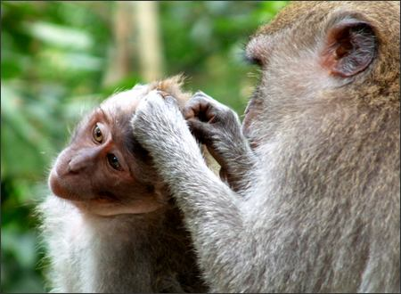
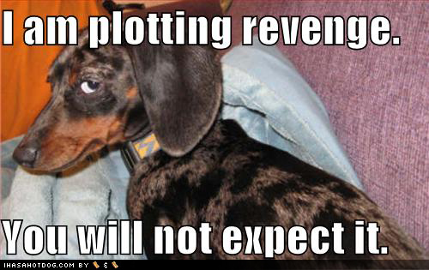
Stage 2: Individualism and Exchange

Slide 8
Stage 3: Good Interpersonal Relationships
What is right is people living up to the expectations of the family and community and behaving in “good” ways.
Vengeance is collective, meaning individuals shouldn’t take out revenge on those who have wronged them
Failure to punish is “unfair”; “If he can get away with it, why can’t I?”
Heinz was right to steal the drug because “He was a good man for wanting to save her”; the druggist = the villain… “He was unfair, trying to overcharge and letting someone die”

Slide 9
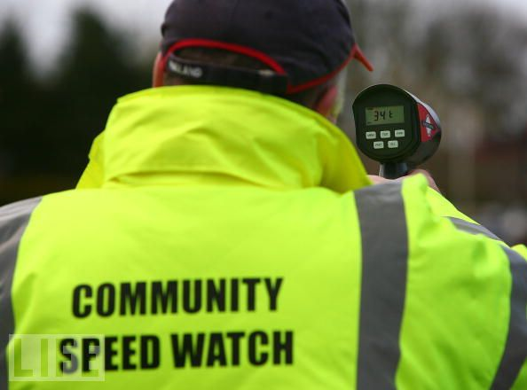
Stage 3: Good Interpersonal Relationships

Slide 10
Stage 4: Maintaining the Social Order
What is right is what is best for society as a whole
The emphasis is on obeying laws, respecting authority, and performing one’s duties so that the social order is maintained… “If everyone acted in this way, what would happen to society?”
“Heinz’s motives were good, but I cannot condone the theft. What would happen if we all started breaking the laws whenever we felt we had a good reason?”

Slide 11
Stage 4: Maintaining the Social Order

Slide 12
Stage 5: Social Contracts and Individual Rights
What is right is based on rights, laws, and values of society, even against rules of a group
People in this stage speak of “morality” and “rights” as taking precedence over particular laws
Moral action is defined by logical application of universal, abstract moral principles
“It is the husband’s duty to save his wife. The fact that her life is in danger transcends every other standard you might use to judge his action. Life is more important than property.”

Slide 13
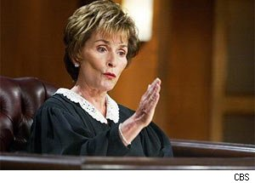
Stage 5: Social Contracts and Individual Rights

Slide 14
Stage 6: Universal Principles
What is right is based on universal ethical principles applying to all people and upon which society’s rules are based.
Every individual is due consideration of his / her interests in every situation, those interests being of equal importance with one’s own
People see situations from the perspectives of others— “The druggist should have understood Heinz’s situation, and vice-versa”
Some laws are morally repugnant, I.E. they break codes of morality, and, thus, don’t need to be followed

Slide 15
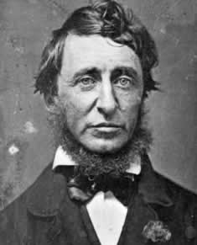
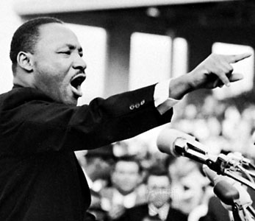
Stage 6: Universal Principles

Slide 16
Overall…
How would you describe the progression from one stage to another throughout this theory?
At what stage would you place your answer for the Heinz situation?

