Slide 1
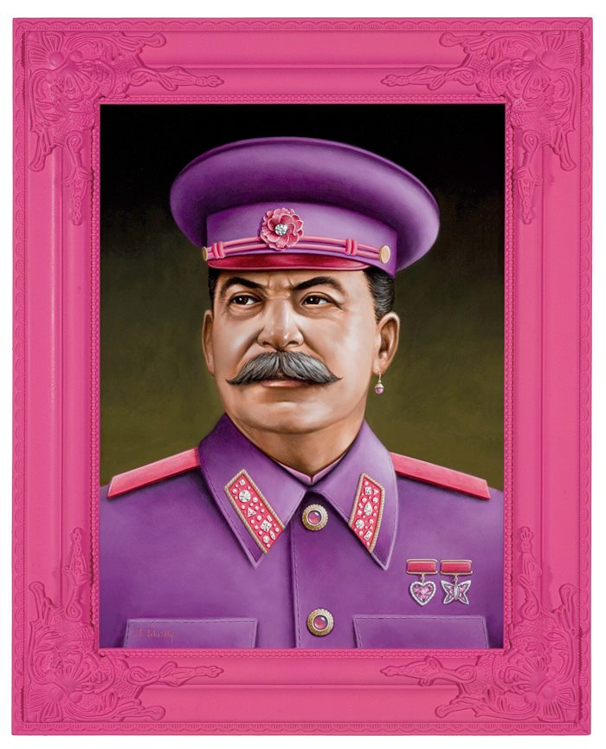
One for the Motherland
Danny & Evan

Slide 2
Writing Activity
Imagine yourself as a Russian citizen (Cold War or otherwise). Describe the events of your normal day. Include elements of your job, community, financial situation, interests, etc.

Slide 3
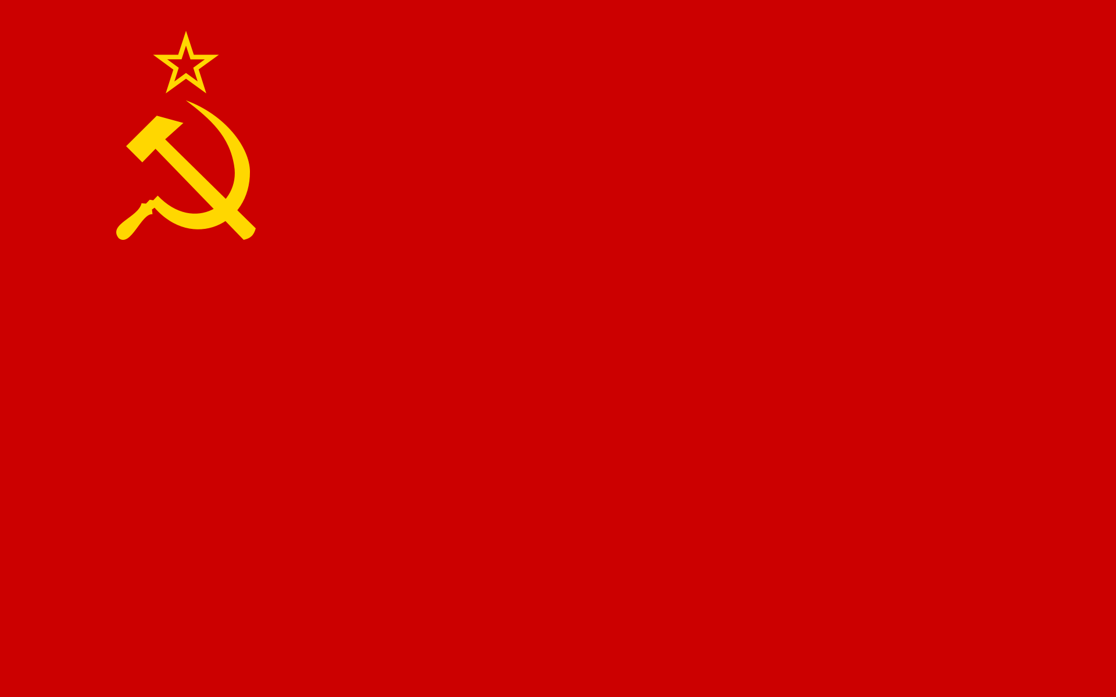
Goals
Explore the history behind our stereotypes of Russia
Evaluate how realistic our perceptions are
See how Russian stereotypes are satirized today

Slide 4
History - 1917
Russians had lost faith in Czarist leadership
Government corruption
Nicholas would repeatedly dissolve parliament for his own benefit
Backward economy
WWI
Russia had greater casualties than anyone in any previous war. Ever.
Immediate cause of the February Revolution

Slide 5
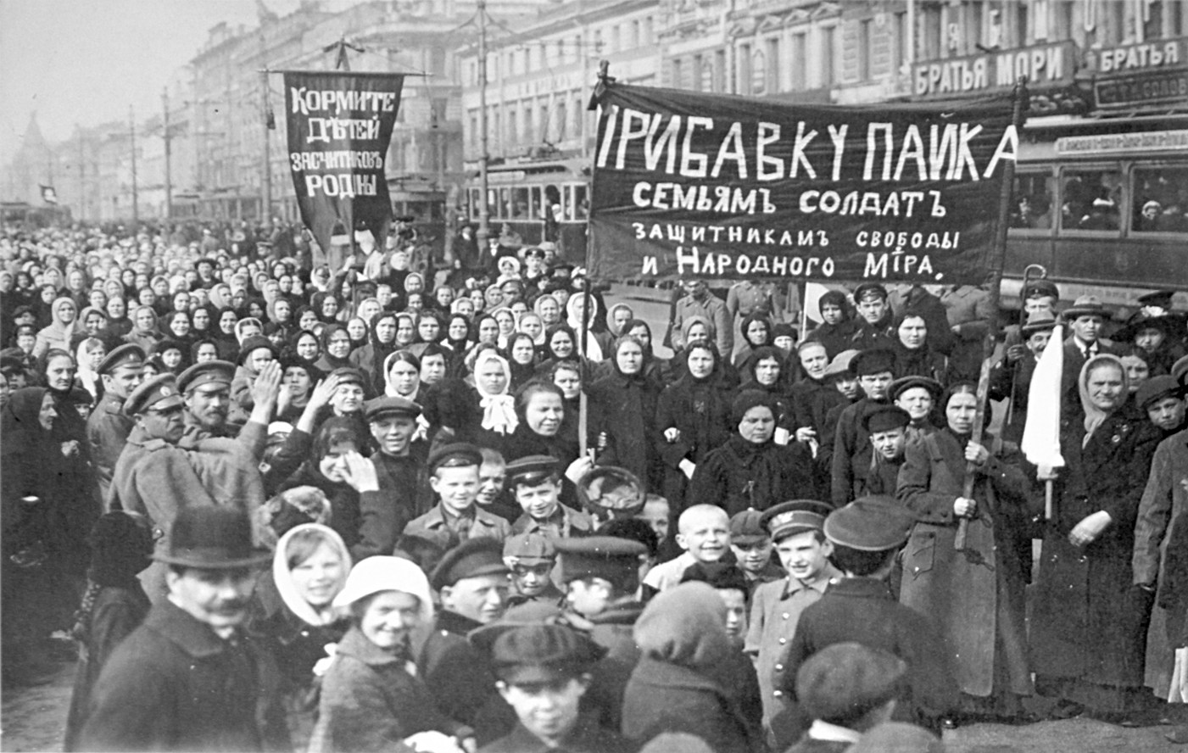
History – February Revolution
Demonstrators demanding bread took to the streets in St. Petersburg
Imperial government was forced to resign
Existing parliament (Duma) shared power with the new Soviets

Slide 6
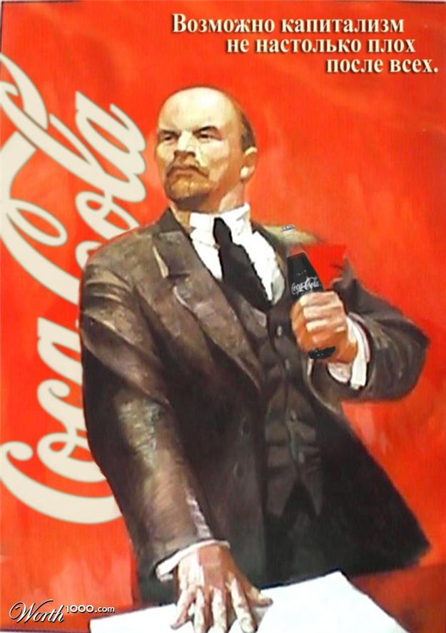
History – October Revolution
AKA: Bolshevik Revolution
Revolutionaries led by Bolshevik Party leader Vladimir Lenin launched a nearly bloodless coup against provisional government
1918 - Fought a civil war with anti-Bolshevik White Army forces
1920 – Anti-Bolsheviks were defeated
1922 – Union of Soviet Socialist Republics was established

Slide 7
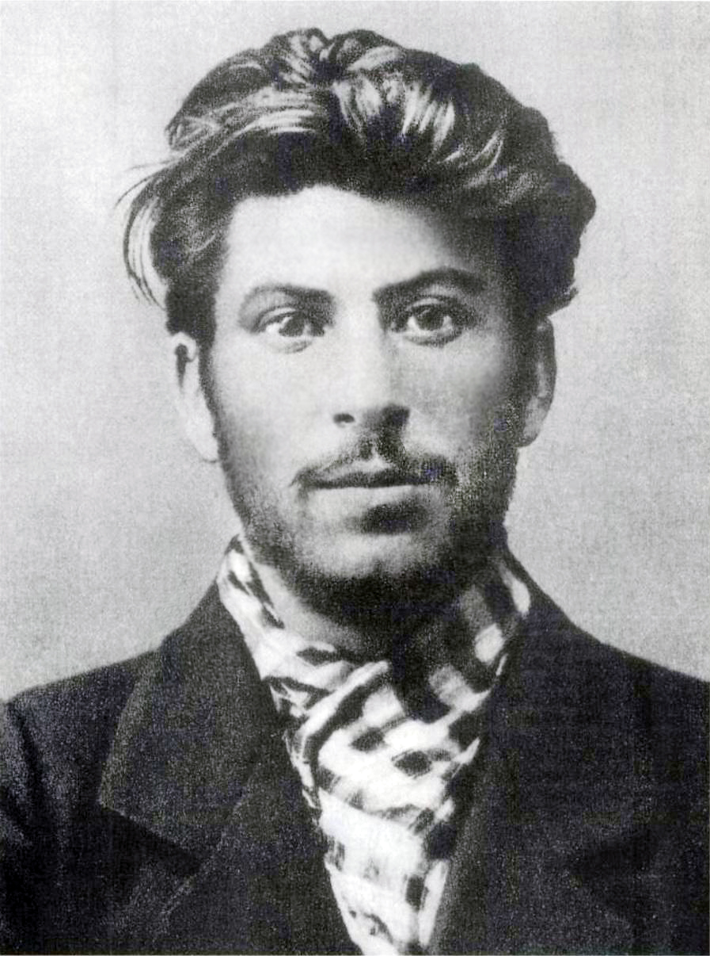
Soviet Leaders
Vladimir Lenin (December 30, 1922 – January 21, 1924)
Joseph Stalin (January 21, 1924 – March 5, 1953)
Georgy Malenkov (March 5, 1953 – March 16, 1953)
Nikita Khrushchev (March 27, 1955 – October 14, 1964)
Leonid Brezhnev (October 14, 1964 – November 10, 1982)
Yuri Andropov (November 12, 1982 – February 9, 1984)
Konstantin Chernenko (February 13, 1984 – March 10, 1985)
Mikhail Gorbachev (March 11, 1985 – December 25, 1991)

Slide 8
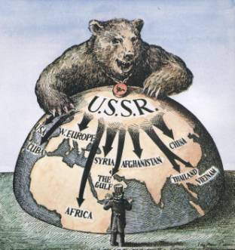
The Cold War
Power struggle between U.S. and Soviet Union. Never actually fought, but used other countries to promote ideologies
U.S. helped South Vietnam and rebel Afghans while Soviets supplied North Vietnam and invaded Afghanistan

Slide 9
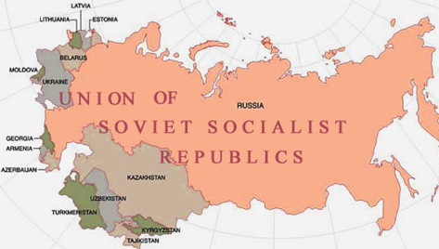
The USSR
Poor economic base
Communist dictatorship
Socialist
Censorship and secret police

Slide 10
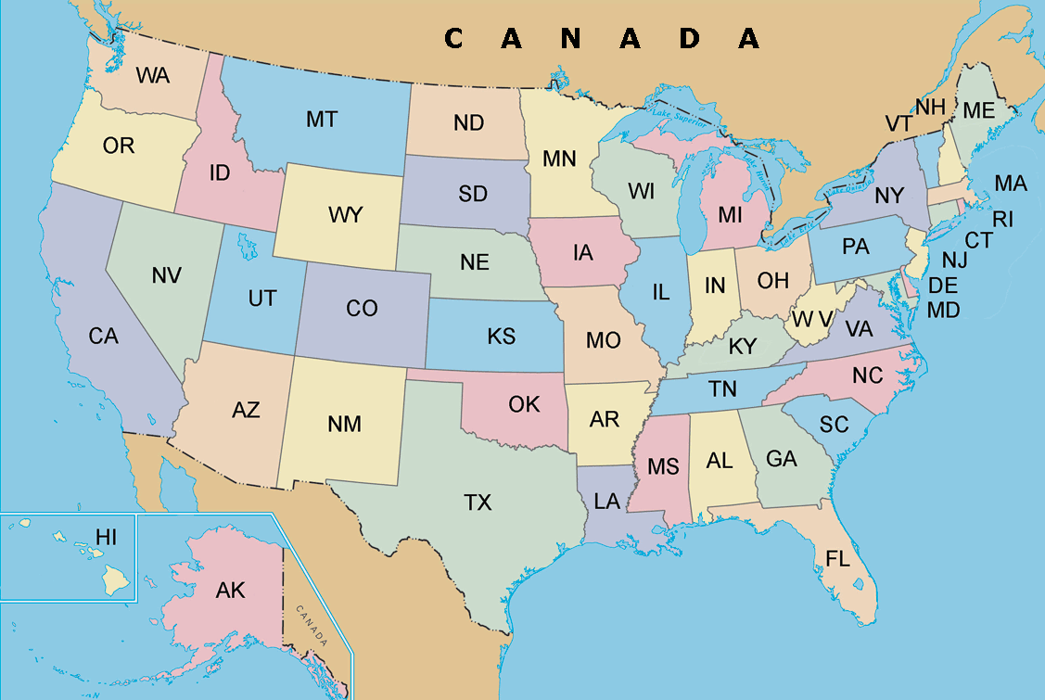
The USA
Stressed individualism
Democratic Republic
Capitalist
Strong economy

Slide 11
Propaganda
N. The systematic propagation of a doctrine or cause or of information reflecting the views and interests of those advocating such a doctrine or cause.
http://www.thefreedictionary.com/propaganda

Slide 12
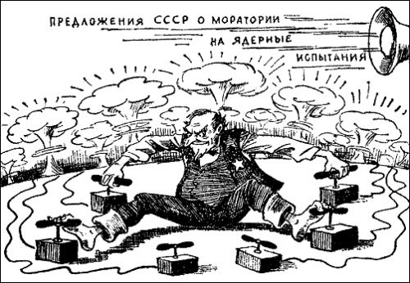
Uncle Sam in a ring of nuclear bomb switches; loudspeaker says “Soviet Union offers to stop nuclear weapon tests”.

Slide 13
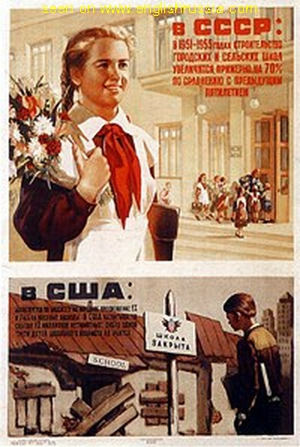
In Soviet Russia, schools open. In America, schools close.
http://englishrussia.com/2006/09/20/soviet-propaganda-against-usa-posters/

Slide 14
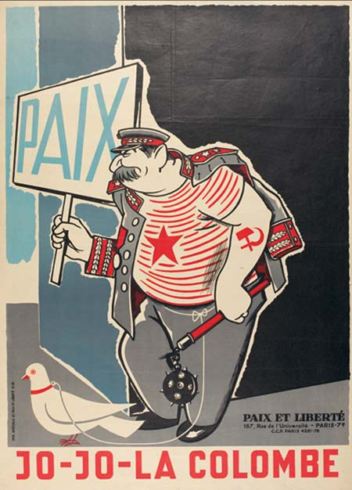
By French Anti-Communist group: Stalin holding peace sign in one hand with a weapon in the other.

Slide 15
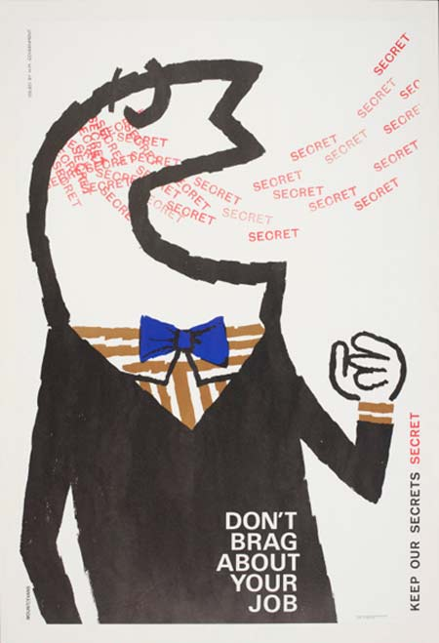
1960 British poster implying Soviet spies were lurking.
http://www.designer-daily.com/10-amazing-cold-war-propaganda-posters-2901

Slide 16
Drift: US v. USSR
Reagan increased military spending from $150 billion to $300 billion a year during his 8 year term by feeding on the fears people had over the possibility that the Soviets would attack. Had to make people believe the threat was real.

Slide 17
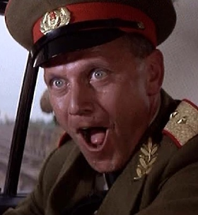
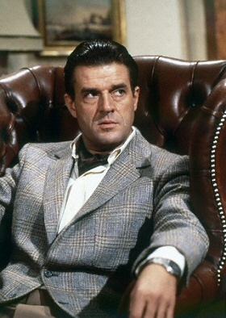
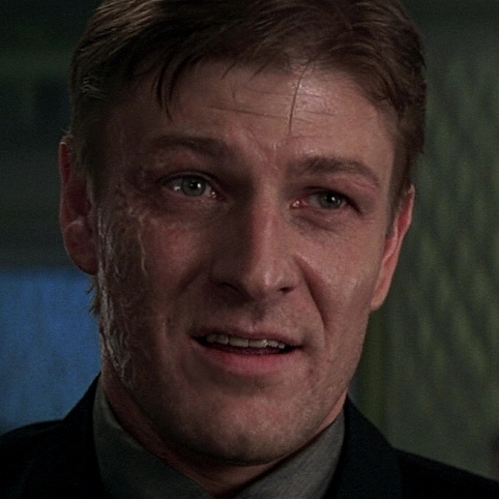
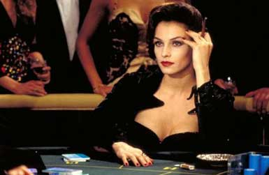
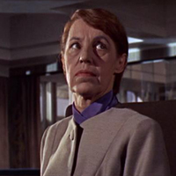
Satire
James Bond
Rosa Klebb
Kamal Khan
General Orlov
Georgi Koskov
Alec Trevelyan
Xenia Onatopp

Slide 18
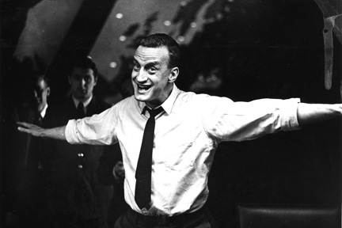
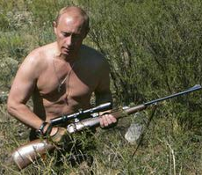
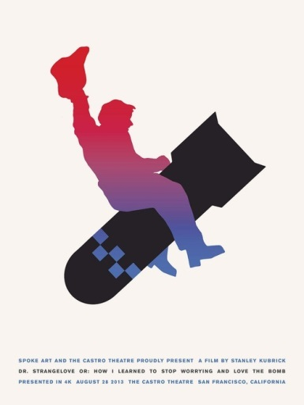
Satire
Dr. Strangelove, or How I Learned to Stop Worrying and Love the Bomb
http://www.theonion.com/articles/how-russia-is-preparing-for-the-winter-olympics,35097/
http://www.theonion.com/articles/russian-man-recalls-oppressive-days-under-communis,33492/

Slide 19
World War Z
Father Sergei Ryzhkov (pg. 292)
Faulty guns, reckless strategy.
Having to kill infected soldiers. He started the tradition of having chaplains kill the infected.
First step to religious fervor across nation known as Final Purification.
Russian president declared himself leader of the Church and organized priests into “death squads” which assassinated people under the premise of “purifying infected victims.”

Slide 20
World War Z
Maria Zhuganova (pg. 76 & pg. 329)
Soldier at Lake Baikal in central Southern Russia. The military took their TVs and cell phones and sent them looking for something, although the unit did not know what.
Unit found out about zombies and wanted to go home. Spetznaz trapped them, and then the decimation started.
Later, when she is pregnant with her 8th child, she seems oddly patriotic despite her previous loathing for the old Russian patriots from WWII.
Is she more patriotic or does she still dislike the idea of Russian patriotism?

Slide 21
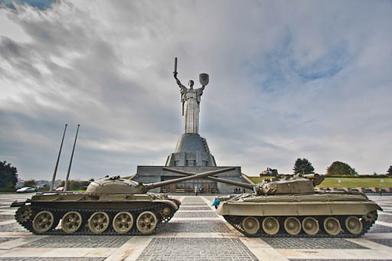
World War Z
Bohdan Taras Kondratiuk (pg. 116)
Saw civilians gassed with weapons from the Cold War.
The last building he saw from Kiev was the Great Patriotic War Museum Complex dedicated to when the Soviet Union fought Germany.

