Slide 1
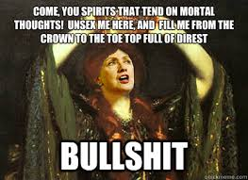
Macbeth: Unsexed Act 1, Scenes 5-7
Chris Asgian and Joe Pappalardo

Slide 2
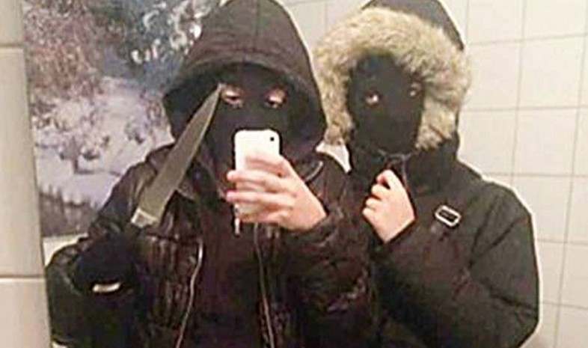
A brief overview
Macbeth invites King Duncan back to his crib
Lady Macbeth seeks to be Queen
Plots murder – needs Macbeth
Macbeth gets cold feet
Lady Macbeth delivers the bottom line
Then…

Slide 3
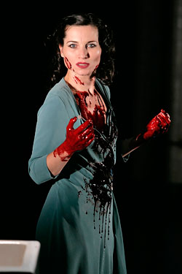
Speaker
Lady Macbeth
Macbeth too
Vain, opposite of
Macbeth
Changes the man

Slide 4
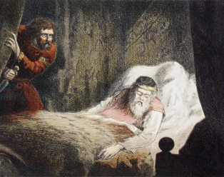
Occasion
Macbeths’ slumber party turns into catastrophe
Macbeth hesitates for the hundredth time

Slide 5
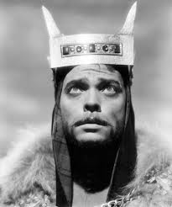
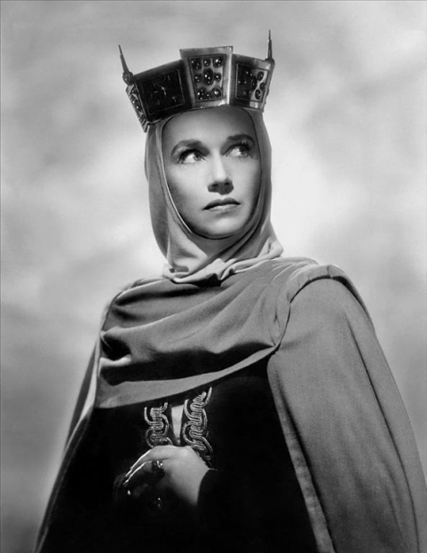
Audience
Macbeth
Lady Macbeth, play audience

Slide 6
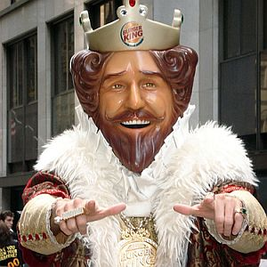
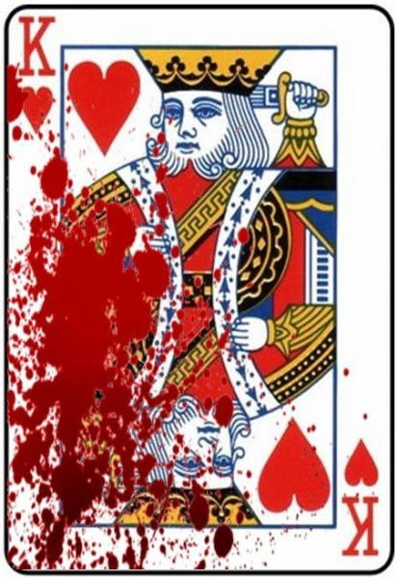
Purpose
King Duncan needs to die…will Macbeth do it?

Slide 7
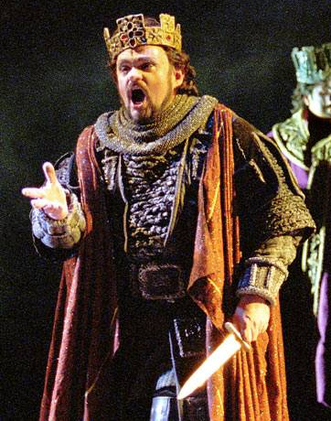
Subject
The kingdom
Murdering Duncan
Macbeth’s manliness
“you won’t do it?”
Fame over love

Slide 8
The footage
https://www.youtube.com/watch?v=Fe5uRWnzUig

Slide 9
The unsexing
(Scene 7) – Lady Macbeth
47 What beast was't, then, 48 That made you break this enterprise to me? 49 When you durst do it, then you were a man; 50 And, to be more than what you were, you would 51 Be so much more the man. Nor time nor place 52 Did then adhere, and yet you would make both: 53 They have made themselves, and that their fitness now 54 Does unmake you. I have given suck, and know 55 How tender 'tis to love the babe that milks me: 56 I would, while it was smiling in my face, 57 Have pluck'd my nipple from his boneless gums, 58 And dash'd the brains out, had I so sworn as you 59 Have done to this.

Slide 10
Rhetoric
Metaphor – “beast”
Parallel Structure
Inversion
Juxtaposition
Anecdote
Ethos
She’s a man(?)
Want best for the man
Logos
When you make it big….
Pathos
Sacrifice – baby
Escalates towards devilish deeds

Slide 11
Tone
Defiant
“murderous”
Guilty

Slide 12
Works cited
"In Act 1 Scenes 5-7 of 'Macbeth', How Does Lady Macbeth Convince Her Husband to Murder King Duncan?" Studymode. N.p., Oct. 2010. Web. 23 Sept. 2013. <http://www.studymode.com/essays/In-Act-1-Scenes-5-7-Of-440132.html>.
Shakespeare, William. "Macbeth: Act 1, Scene 7." MACBETH, Act 1 Scene 7. N.p., n.d. Web. 23 Sept. 2013. <http://www.shakespeare-navigators.com/macbeth/T17.html>.
Shakespeare, William. "SCENE V. Inverness. Macbeth's Castle." SCENE V. Inverness. Macbeth's Castle. MIT, 1993. Web. 23 Sept. 2013. <http://shakespeare.mit.edu/macbeth/macbeth.1.5.html>.

