Slide 1
Synthesis: Entering the Conversation and Demonstrating a Balanced, Educated Voice
AP Language and Composition
Mr. Eble

Slide 2
What is the Synthesis question?
According to the College Board website, this question “asks students to synthesize information from a variety of sources to inform their own discussion of a topic” (apcentral.collegeboard.com).
Similar to the DBQ on the AP U.S. History Exam.
In short, this is an essay which you should read the available sources and utilize them to craft a balanced, knowledgeable argument in which you demonstrate argumentative balance.

Slide 3
Types of “texts” you can expect to see…
Traditional text-based documents | Visuals
Opinions / Editorials Personal Accounts / Narratives News stories from newspapers, national magazines, online magazines, blogs. Maybe… Poems? Brief fiction? | Graphs / Charts Editorial Cartoons Photographs

Slide 4
What Synthesis Prompts to Expect
defend/challenge/qualify or develop a position about some claim (involves weighing pros and cons and often, cost-benefits analysis of a particular perspective/solution)
evaluate considerations (still an argument, but an argument about which are the most important considerations)

Slide 5
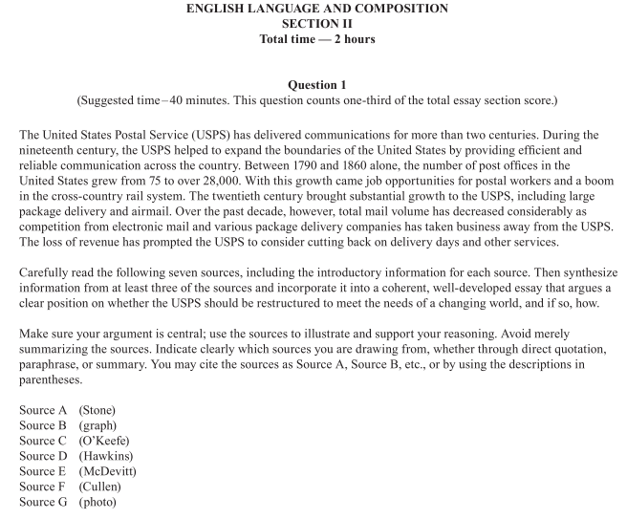
15 minute reading period for entire free-response section
No background information about the topic?
NO PROBLEM!

Slide 6
AP US versus AP Language: Prompt Wording
DBQ
SYNTHESIS ESSAY
Analyze change in political, economic and ideological relations in given categories.
FOCUS: HISTORICAL UNDERSTANDING
Read the following sources (including any introductory information) carefully. Then, in an essay that synthesizes at least three of the sources for support, take a position that defends, challenges, or qualifies the claim that television has had a positive impact on presidential elections.
FOCUS: ARGUMENTATION & RHETORICAL ANALYSIS

Slide 7
AP US versus AP Language: Number of Documents and Content
DBQ
SYNTHESIS ESSAY
In general, about 10 documents are present, they include maps, direct historical sources, newspaper mastheads.
In this particular DBQ, there are 8.
6 or 7 op eds, visuals (including graphs or charts), statistics, facts, background on the issue.

Slide 8
AP US versus AP Language: How to Cite (and How Many)
DBQ
SYNTHESIS ESSAY
Use half the documents plus one.
“………..” (Doc A).
Use amount stated on the essay, usually 3.
“……..” (author’s last name).
OR
“……..” (Source A).
Citation should immediately follow whatever is borrowed from/shared with the document (standard MLA).

Slide 9
AP US versus AP Language: Background and Outside Knowledge
DBQ
SYNTHESIS ESSAY
Required.
You should know the issue and all relevant historical information.
Not required.
It is useful to understand the basics of the issue.

Slide 10
AP US versus AP Language: Structure
DBQ
SYNTHESIS ESSAY
Divide paragraphs by the categories (i.e. political, economic, social).
Organize essay so as to best present comprehensive information in response to prompt.
Classical Argument Structure
Short introduction with interesting hook
Divide body paragraphs by considerations or facets of the argument, or by your own Tier 1 reasons
Cite as many sources as possible in support of YOUR argument!

Slide 11
AP US versus AP Language: Overall Skills Required to be Successful
DBQ
SYNTHESIS
Knowledge of history and relevant issues.
Clear writing.
Ability to categorize the documents.
Cover as much information as possible to demonstrate your understanding of the period and integrate documents.
Ability to construct and support argument convincingly.
Ability to define your stance on an argument
Important Note: The focus should be on your own argument, even if all of your knowledge is from the provided sources.
Create an opinion, and use the sources to support it.

Slide 12
Summary of Similarities
DBQ
Synthesis
1. Uses documents to support a thesis
2. Must cite sources
3. Read for 15 minutes (suggested)
4. Do not simply paraphrase, no "laundry list"
5. Must understand the complexity of the historical issue to "enter into a conversation"
6. Consider the author's purpose, audience, and point of view
7. Must develop a clear, organized argument
1. Uses sources to support a thesis
2. Must cite sources
3. Read for 15 minutes (suggested)
4. Do not simply paraphrase, no "laundry list"
5. Must "enter into a conversation"
6. Consider the author's purpose, audience, and point of view
7. Must develop a clear, organized argument

Slide 13
Summary of Differences
DBQ
Synthesis
1. Documents provided
2. Only primary sources used
3. Suggested writing time of 35 minutes
4. Outside information required
5. Must use more than half of the documents
6. Directions with statement or question
1. Sources provided
2. Primary and secondary sources used
3. Suggested writing time of 40 minutes
4. Outside information not required
5. Must use a minimum of three sources
6. Prompt in three parts: directions, introduction, and assignment

Slide 14
