Slide 1
King Claudius: Act 1 Scene 2
By: Andrew Carmichael & John Dickens

Slide 2
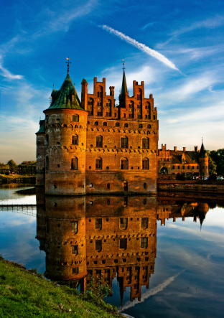
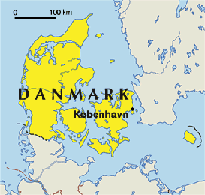
Background
The play is set in Denmark in the late middle ages, even though things in the Elizabethan era are sometimes referenced by characters.
King Claudius has just slain his brother, Hamlet, less than two months earlier.
Claudius intends to marry Gertrude, Hamlet’s widow.

Slide 3
CLIP
http://www.youtube.com/watch?v=p2RHXt9t-d4

Slide 4
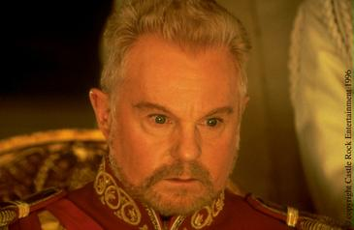
Speaker
King Claudius
King of Denmark after Hamlet
Killed his own brother to obtain power
Needs to address Hamlets death carefully

Slide 5
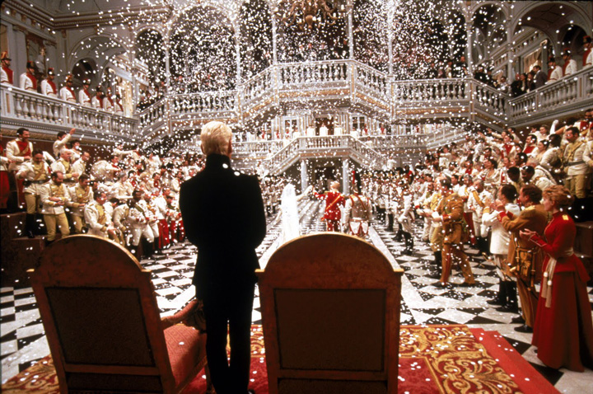
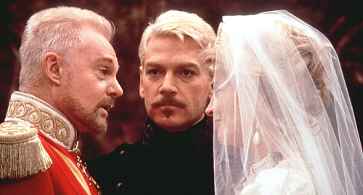
Occasion
Claudius is at a party and announces the marraige
Hamlet’s widow
Everyone is gathered for a party and King Claudius is going to give a speech.

Slide 6
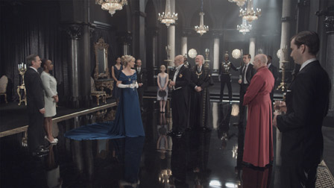
Audience
The audience is everyone who is attending the party
These are people that Claudius needs to appeal to, because he must work hard to justify him marrying his brother’s widow. Also, must address his brother’s death and show grief.
(especially so soon)

Slide 7
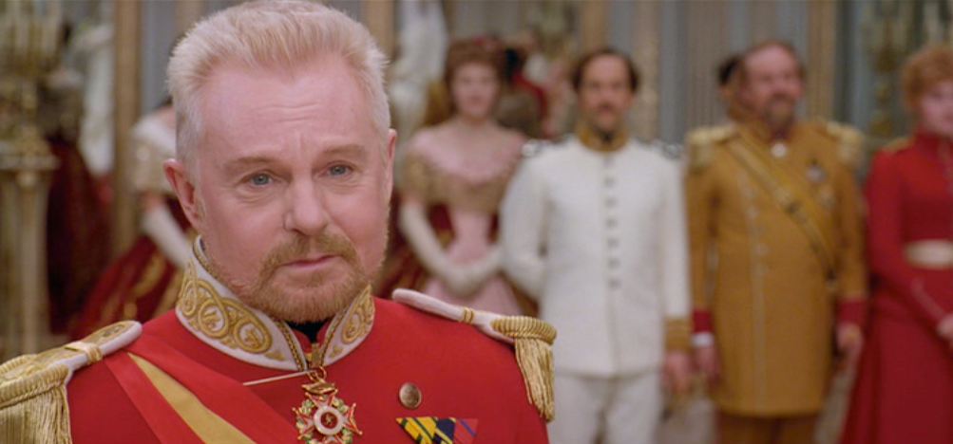
Purpose
The purpose of this speech is to rally the spirits of the people and help them get over the loss of Hamlet.
Basically, Hamlet’s loss is tragic, but good things are to come.

Slide 8
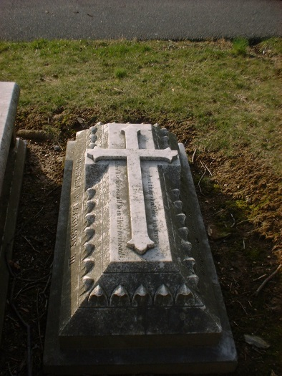
Subject
He has to seem like he is sad for Hamlet’s death, so the speech is sincere. He keeps saying his brother was a good man and he will be missed.
”With mirth in funeral and with dirge in marriage, In equal scale weighing delight and dole”
Grieve the funeral, but be joyous for our wedding. Let our wedding fill you with joy

Slide 9
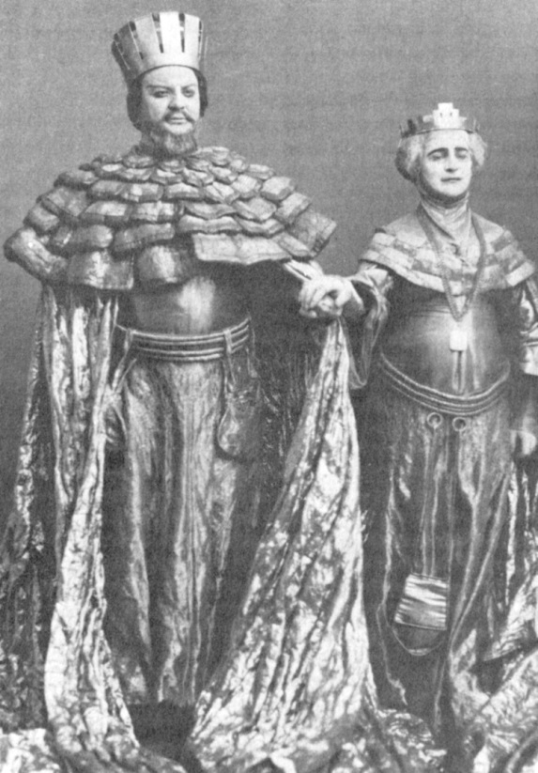
Rhetorical Devices
Ethos
King
Hamlet’s brother
Queen
Not all bad
Cornelia and Voltimand
Ambassadors to Old Norway

Slide 10
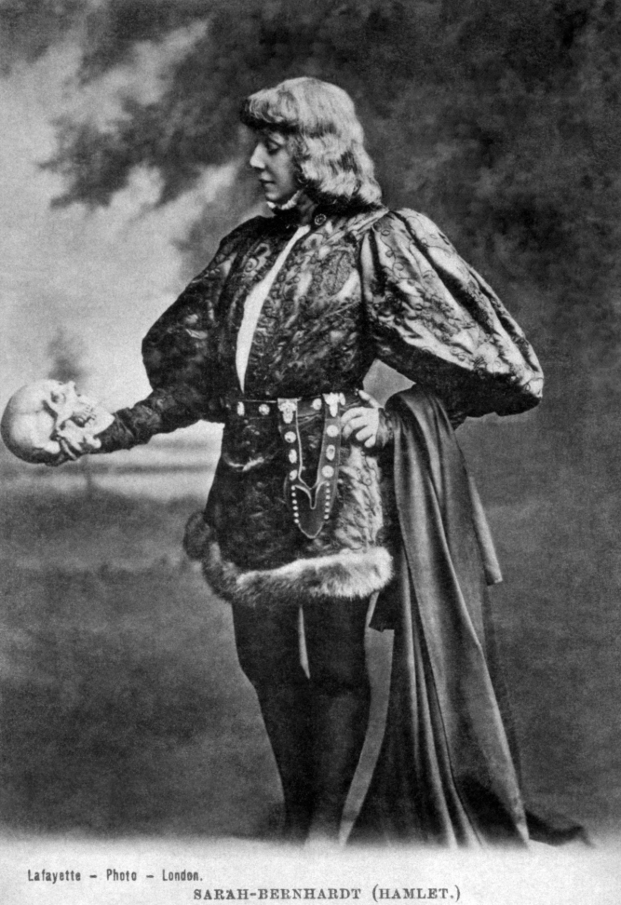
Cont.
Logos
So far hath discretion fought with nature
No one’s fault
Pathos
Our brother
Memory be green
Bear our hearts in grief/our whole kingdom
Defeated joy

Slide 11
Tone
Starts sympathetic/emotional
Memory
Humor/Thankful
Not all bad
Move on

Slide 12
Work Cited
Shakespeare, Absolute. "Hamlet, Prince of Denmark." Shakespeare's Hamlet at Absolute Shakespeare. Absolute Shakespeare, 2005-2009. Web. 26 Sept. 2013.
Hamlet - David Tennant, Patrick Stewart, Penny Downie. Act One, Scene 2. - Pt.1. Perf. David Tennant, Patrick Stewart, Pennie Downie. YouTube, 2010. Online.

